Slide 1
USING COTS SIMULATION TO FACILITATE A CPX
Experience of using Wargame Red Dragon by RMAS cadets 2018

Slide 2
BACKGROUND
I am an infantry officer of 7 years experience who currently instructs at RMAS. I command ‘Lucknow’ Platoon which is where the cadets who are too injured to continue the commissioning course are housed. They spend half of each day in rehabilitation and the other half conducting military training. The military syllabus includes a week on Offensive, Defensive and Enabling Operations. This CPX was designed to support the understanding of Defensive Doctrine.
I myself have played Wargame Red Dragon and its predecessors repeatedly and, along with manual wargames, have sought to use them to assist the education of officer cadets at RMAS.

Slide 3
TRAINING OBJECTIVES
“To simulate a Command Post Exercise of an Armoured Infantry Battle Group deployed in hasty area defence against a numerically superior, near peer, conventional opponent”
Practice cadets in IPE/STAP and defensive doctrine (area defence)
Practice cadets in Reports & Returns (R2) and Voice Procedure (VP)
Exercise cadets in command appointments at BG/Coy level
Exercise cadets in teamwork/leadership of small teams within a larger team construct
Exercise cadets in elements of the Combat Estimate and orders process
Expose cadets to real life frictions; resources, time pressure and uncertainty
To test the utility of a COTS PC game to simulate combined arms warfare in a CPX environment

Slide 4
EXERCISE SCENARIO
Conventional Warfare in a fictional nation (Gorgas) between a NATO led coalition and a near peer, regional opponent (Zabzimek).
NATO forces have transitioned to defensive operations (the focus of the learning module).
1st Battalion Sandhurst Rifles (the team’s fictional unit) has been ordered to hold a key avenue of approach known as ‘the Lucknow Gap’.
Zabzimek Forces are 15km to the North but preparing to push South soon in at least two battalion strength (mechanised infantry).

Slide 5
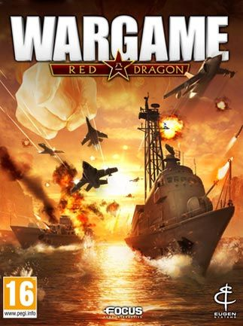
WARGAME RED DRAGON
Eugen System & Focus Home Interactive
1970-1990s Cold War RTS simulation
USSR/Warsaw Pact vs USA/NATO
European Escalation (Feb 2012), Air Land Battle (May 2013), Red Dragon (Apr 2013)
Multiplayer 1x1 - 5x5 over 50 maps
Simulates down to squad/section and individual vehicle level – >1700 vehicles/aircraft/ships modelled.
Area Control & Destruction mechanics
Deck building/balance/tradeoffs

Slide 6
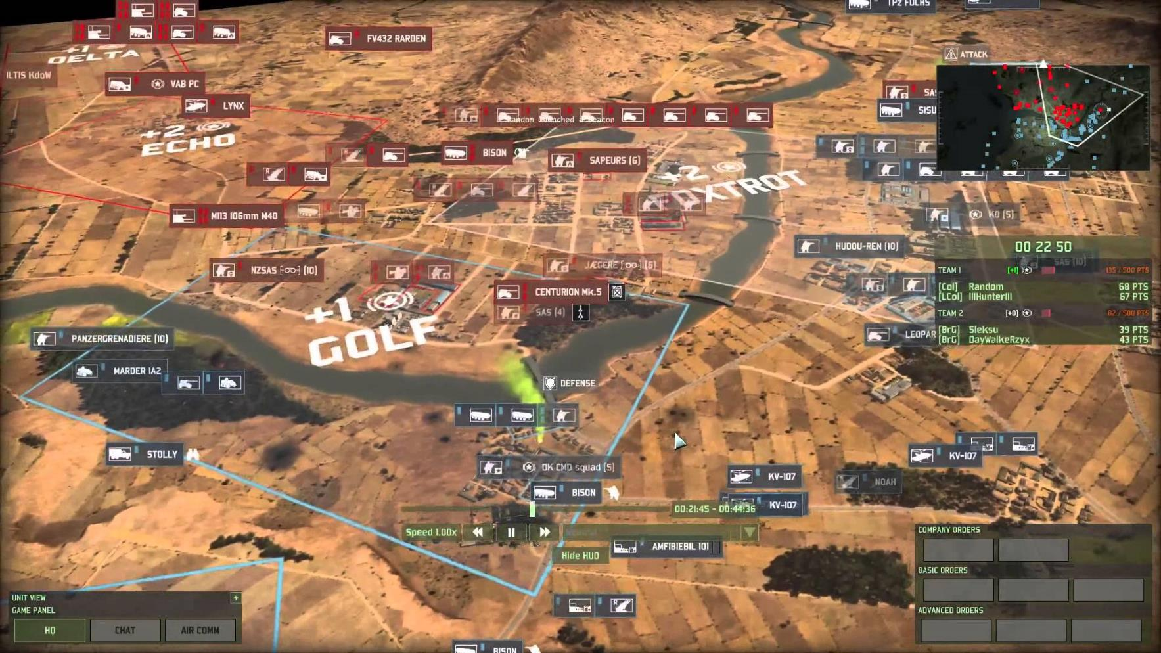

Slide 7
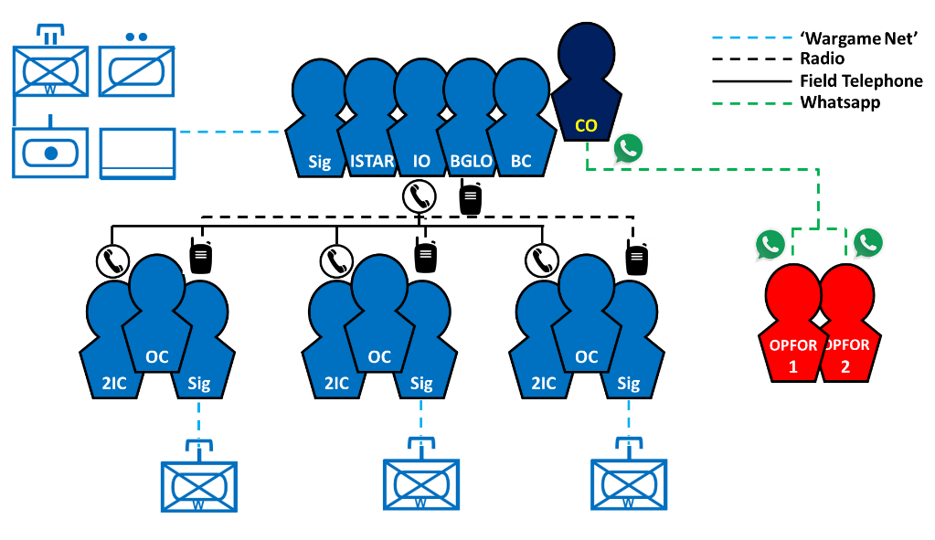
EXERCISE CONSTRUCT
Cadets assigned into teams:
BGHQ (ISTAR, IO, BC, BGLO)
A/B/C Coy (OC, 2ic, Sig)
Opposing Forces (OPFOR)
CO played by permanent staff who also feeds serials to OPFOR. BG roles largely planning/initial phase of battle before coys are engaged.
OC’s and 2ics run the Coy cells with a signaller sending orders to the simulated troops.
Signallers have all played the commercial version before and are familiar with the controls.
FRAGO issued morning of CPX to provide basic context.

Slide 8
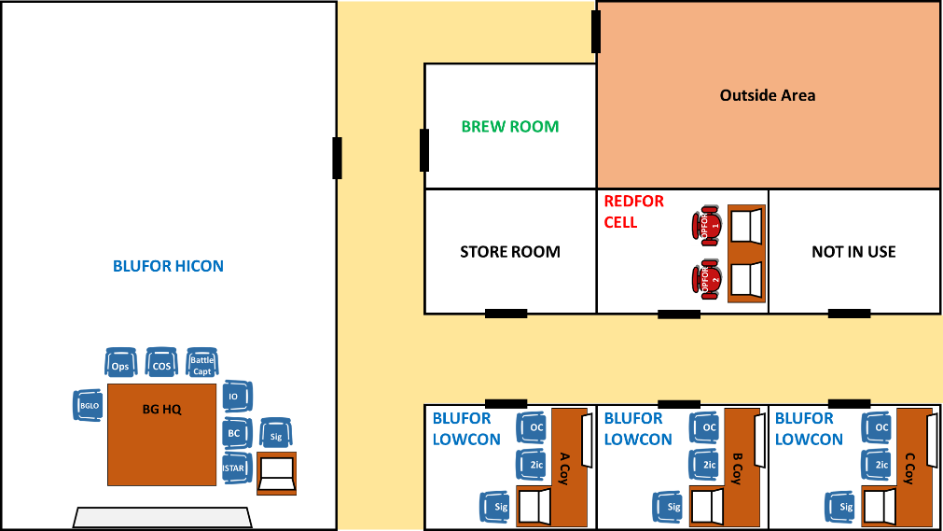
EXERCISE CONSTRUCT
5x ‘Cell’ locations created in accommodation using laptops and TVs:
HICON – BG
LOWCON x3 – A/B/C Coy
RED Cell x1
Cells linked by radio and line (field telephone). Movement between cells is restricted to that which has occurred in the simulation.
OPFOR have an Ex MEL (simulating a Mech Bde launching a series of Bn level attacks from a road march) these are initiated via secure whatsapp messaging.

Slide 9
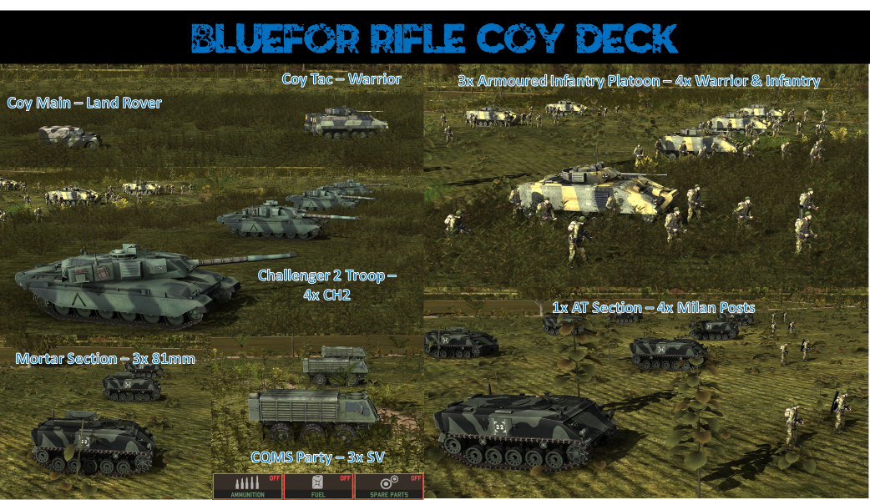
SIMULATED FORCES
COMMAND
MANOUEVRE
MANOUEVRE SUPPORT
Each Coy consisted of :
2x Command Vehicles – a Warrior and Land Rover
3x Armoured Infantry (Mechanised) Platoons of 4x Warrior IFVs and 4x Infantry sections (squads).
1x Armoured Troop of 4x Challenger 2 MBTs
1x AT Section of 4x Milan (Javelin not represented in WRD)
1x Mortar Section of 3x 81mm tracked mortars
Logistic Party of 3x Support Vehicles (carry spares/ammo/fuel)
LOGISTIC SUPPORT

Slide 10
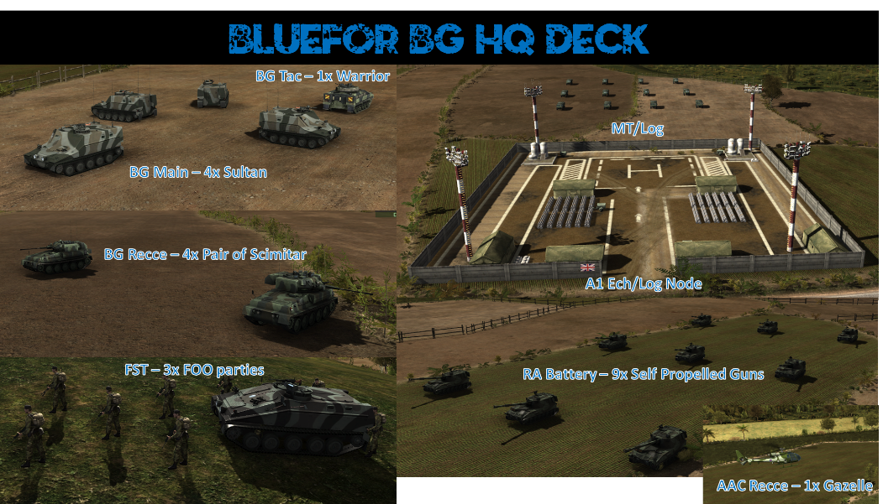
SIMULATED FORCES
COMMAND
ISTAR
FIRES
Battle Group HQ consisted of :
5x Command Vehicles – CO’s Warrior and 4x Sultan Command Posts
8x Armoured Recce (Scimitar) operating in 4 pairs
3x Self Propelled Gun Troops each of 3x 155mm Howitzers (M109s as AS90 not available in sufficient quantity)
3x FOO in Spartan AFV
1x Gazelle Helicopter
Logistic Node and 12 x Support Vehicles (carry spares/ammo/fuel)
LOGISTIC SUPPORT

Slide 11
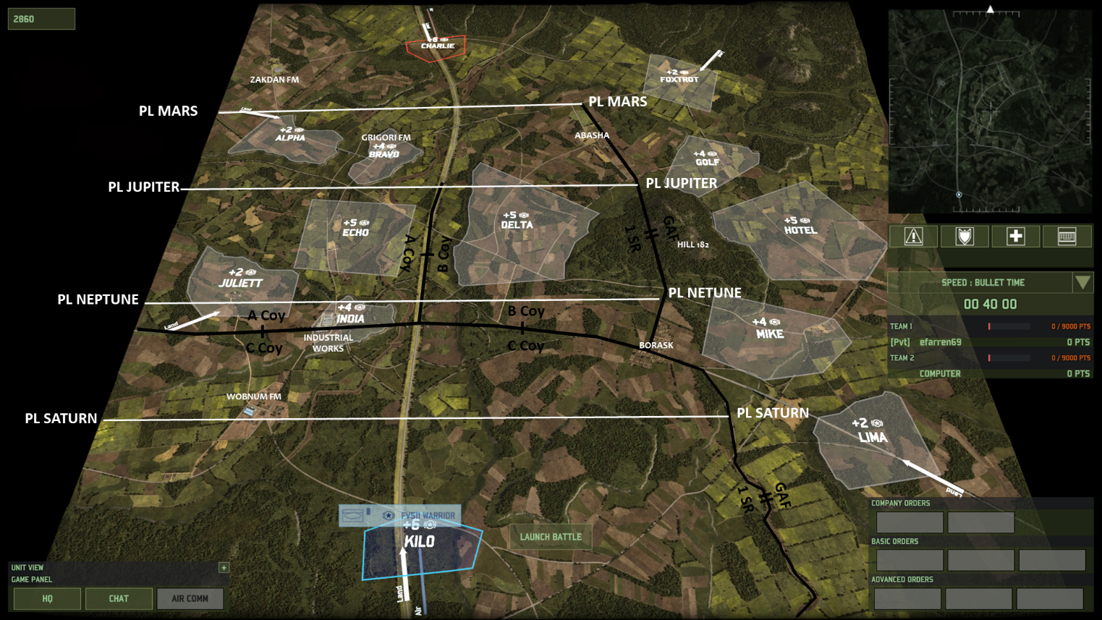
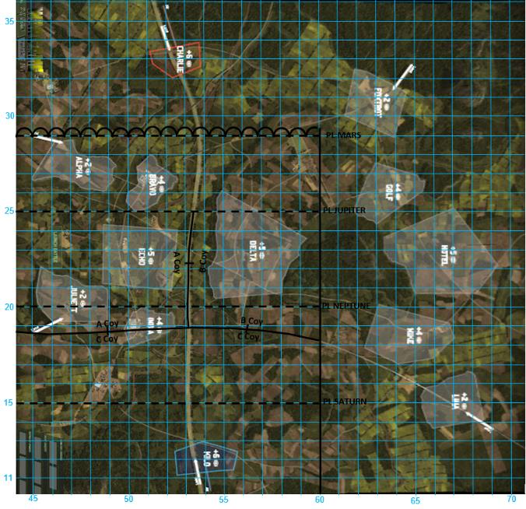
OPERATING ENVIROMENT
Highway to Seoul Map 3vs3 27km²
Contains roads, towns, farms, woods and slopes
BG AO superimposed 16km frontage
Attempted to produce 1:25k map for planning

Slide 12
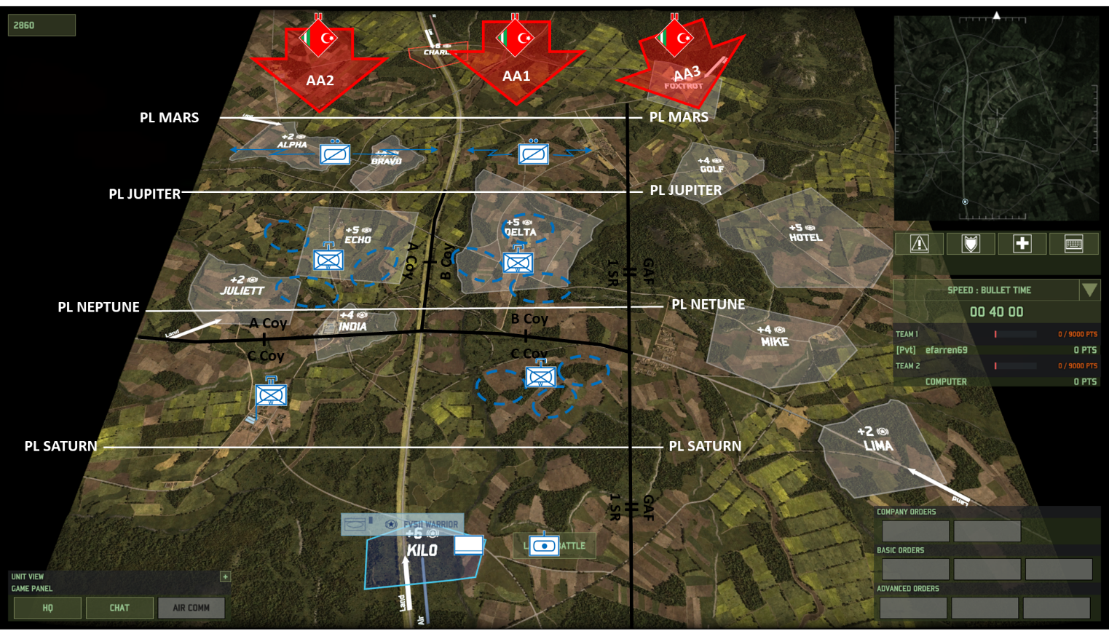
BATTLE PLAN
BLUFOR deployed to Coy Aos in Set Up Phase.
In accordance with current doctrine (Two down siting) they have been given platoon ‘goose eggs’ to site their troops.
CO expects En to press hard along Avenue of Approach 1 (AA1) with a secondary attack along AA2. There is a risk of a flank attack into AA3 and the allied forces there but this is considered the MD COA.

Slide 13
SURVEILLANCE & TARGET ACQUISITION PLAN
OC ISTAR, IO & BC create the BG STAP between PL JUPITER and PL MARS whilst coys create a STAP within their AO
Coy Comds submit STAP to BG after 90 mins, NAIs and TAIs are confirmed and resourced.
Coys then deploy into their final defensive positions on radio silence (field telephones primary comms until contact)

Slide 14
BATTLE PHASES
Initial Deployment & Siting
All troops brought onto the battlefield
Disruption Battle
Recce withdraw in the face of the REFOR advance guard/recce elements
OCs conduct preliminary siting and BB CO
Confirmation of STAP
B Coy Main Battle
Fight in AA1 against REDFOR Coy Gp
A Coy Main Battle
Fight in AA2 against REDFOR Coy Gp
Flank Attack
REDFOR use AA3 to enter BG rear area – triggering a meeting engagement with C Coy
Recce FLET & planning
Following REDFOR withdrawal BG recce’s three enemy positions
Each Coy has an objective to conduct a hasty plan of attack
Final Coy Attacks
Two simultaneous and one sequential Coy attack ends the battle

Slide 15
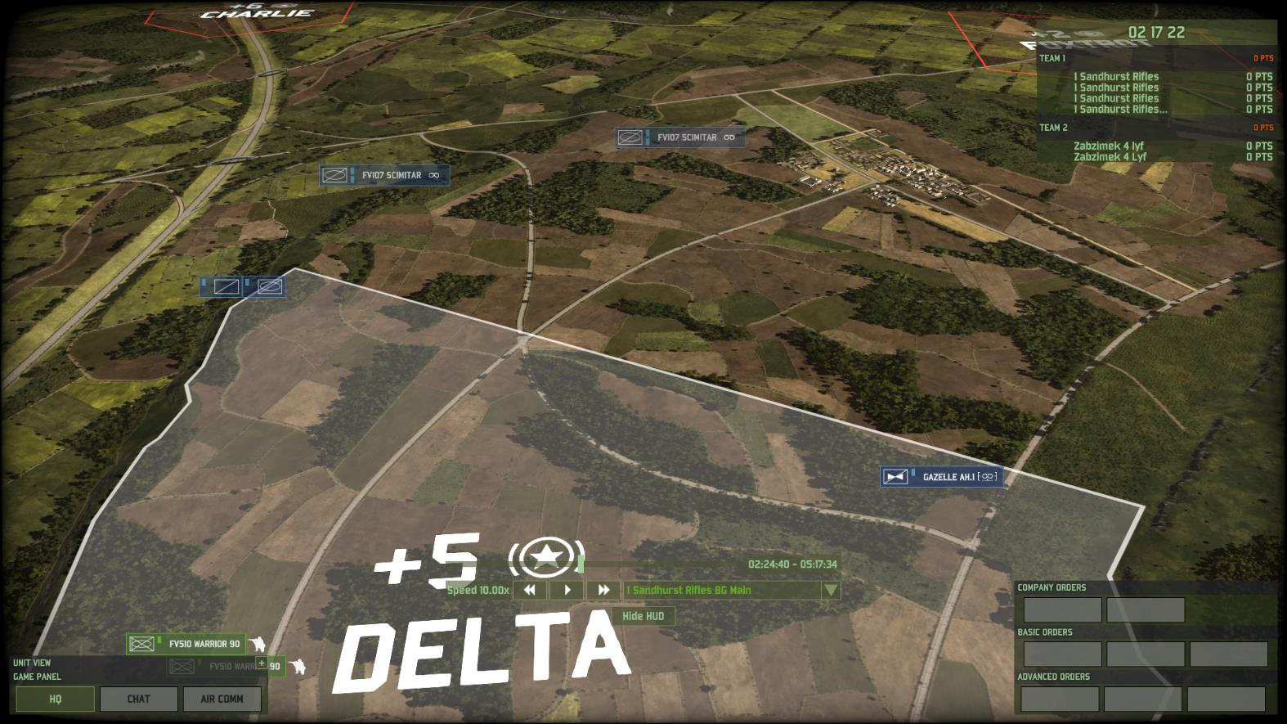
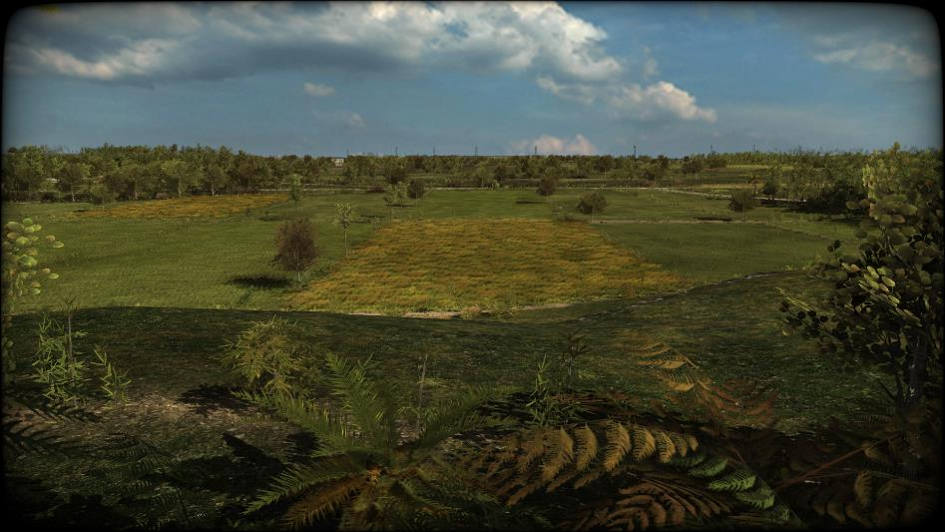
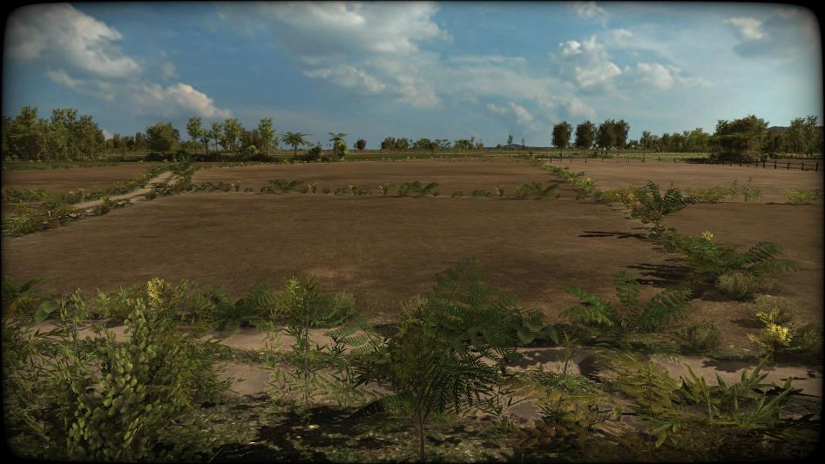
BG RECCE SCREEN AA1 1424 hrs
Anticipated En recce along four possible axis
FOO (linked to FIRES) covers central axis with scimitar pairs on the others.
Gazelle held to E flank (risk of AA3 spill over)

Slide 16
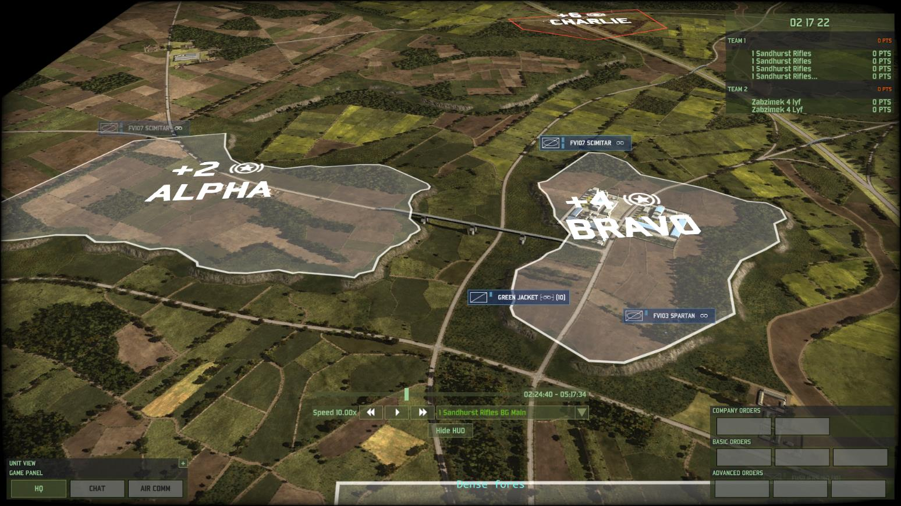
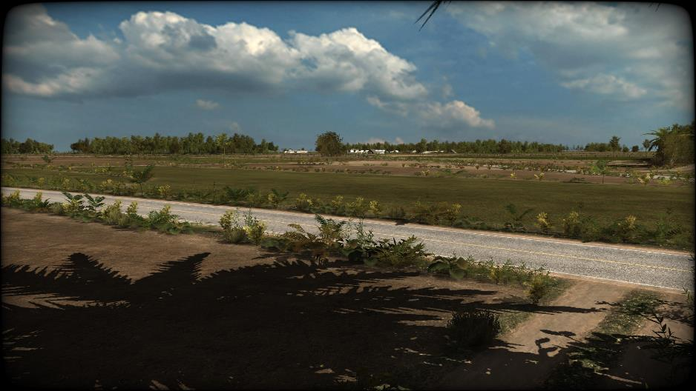
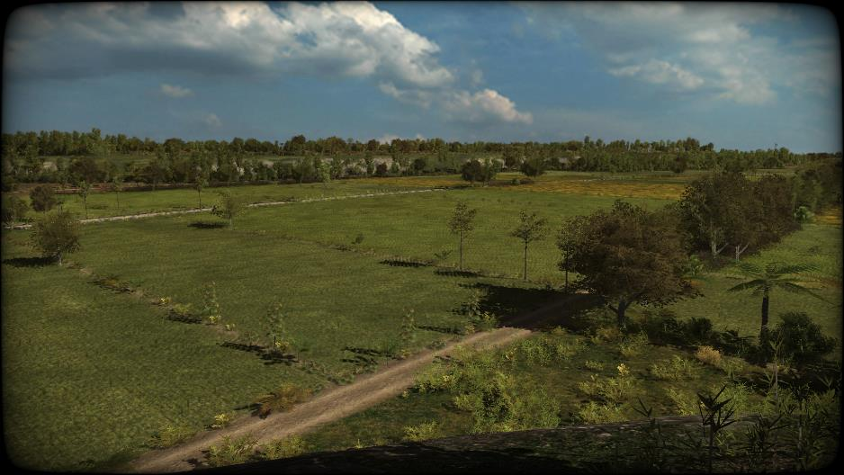
BG RECCE SCREEN AA2 1424 hrs
Threat of broader En advance along this Avenue of Approach but easily covered by scimitar pairs.
FOO in depth to cover the main road junction where forces might link up.

Slide 17
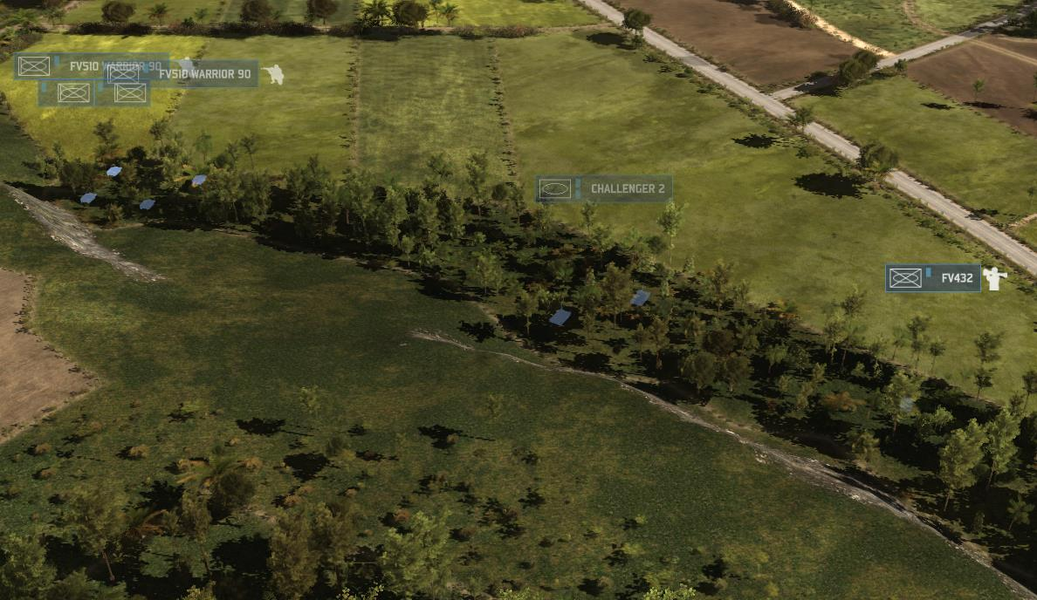
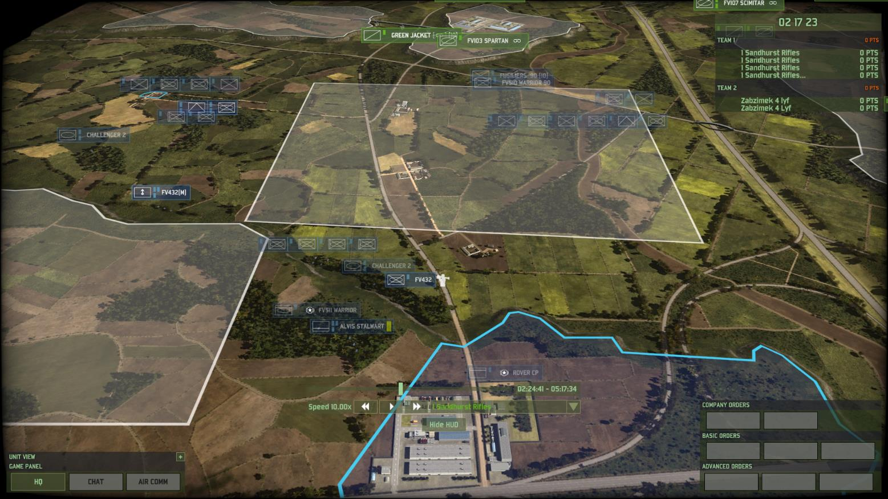
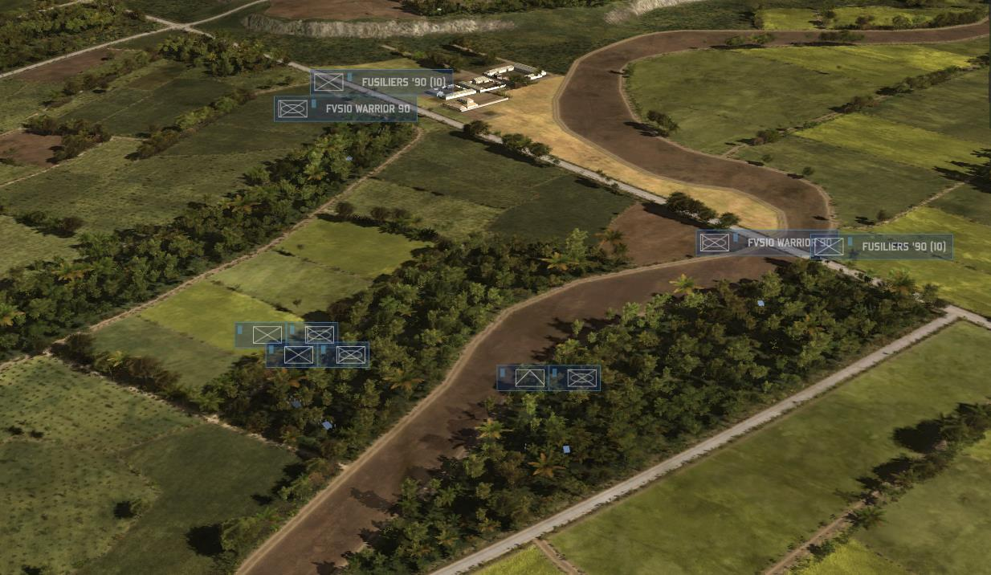
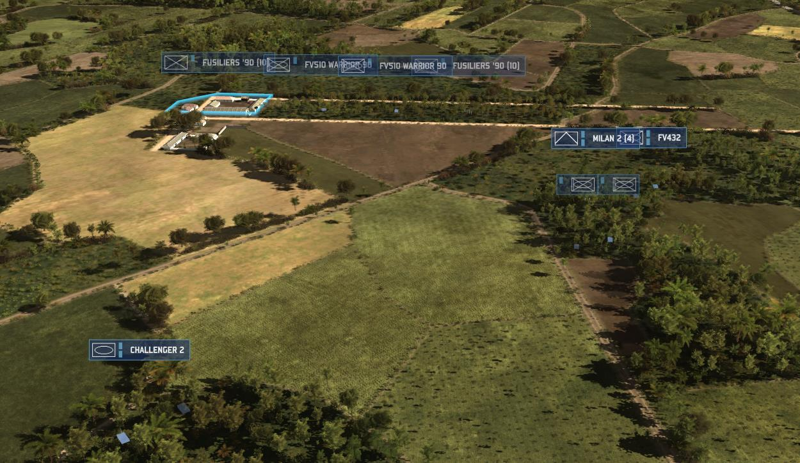
A COY POSITION AA2 1424 hrs
Broadly speaking two up one back with large engagement area astride the N-S road. Tanks split between Front Left Pl and Reserve Pl.
Some key weapons not sited where they can engage effectively
FORWARD RIGHT PLATOON
FORWARD LEFT PLATOON
REAR PLATOON
Two AT dets together!? Limited LoS due to trees
Half platoon forward in cover inc buildings – likely to provide a good block
This forward section is unsupported – OP?
Whole platoon centralised and mounted for rapid movement
Remainder of platoon mounted in Warrior in cover
Tanks have commanding view of the road if En rapidly penetrates/bypasses the forward pls
This section will struggle to cover the open ground to the N without longer range asset (Milan?)
Two sections held in cover but cannot engage or support other FEs in Pl positions.
AT det mounted in reserve?
Half Troop of Challenger 2 in reserve able to interdict penetrations/outflanking
Anti Tank Det has no LoS!

Slide 18
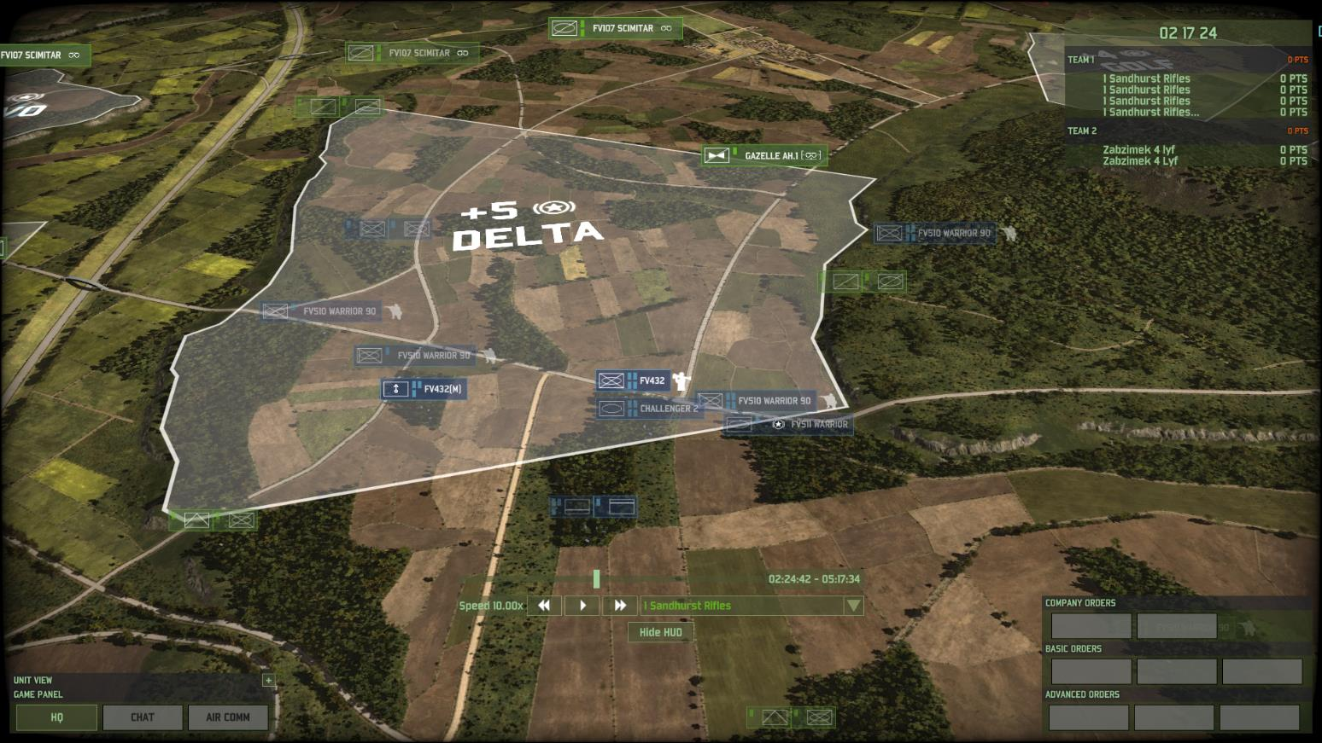
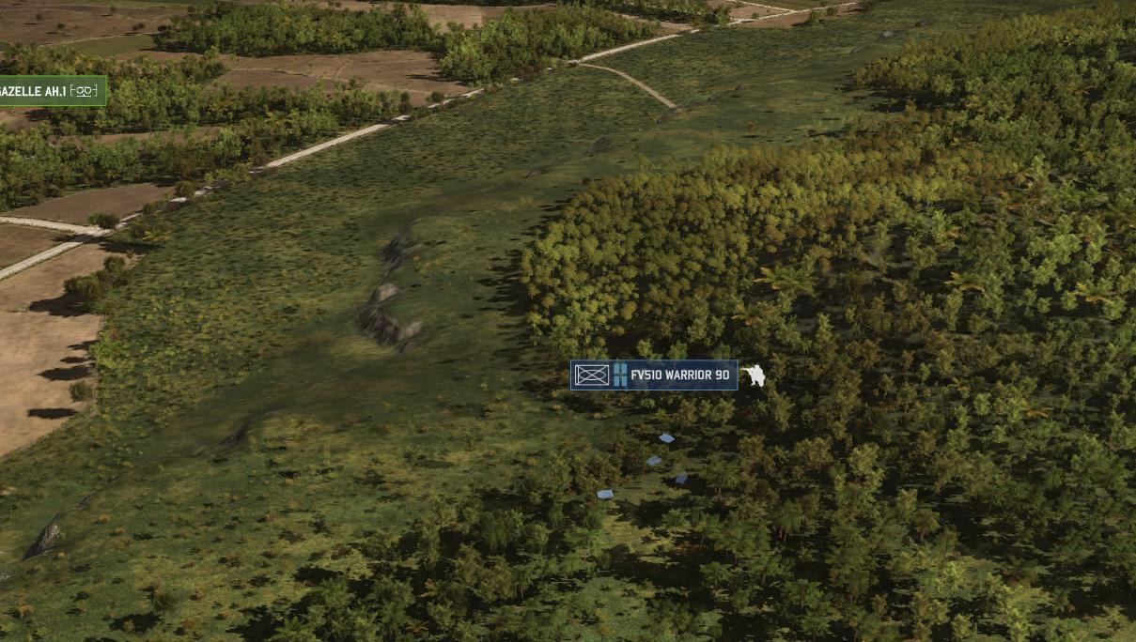
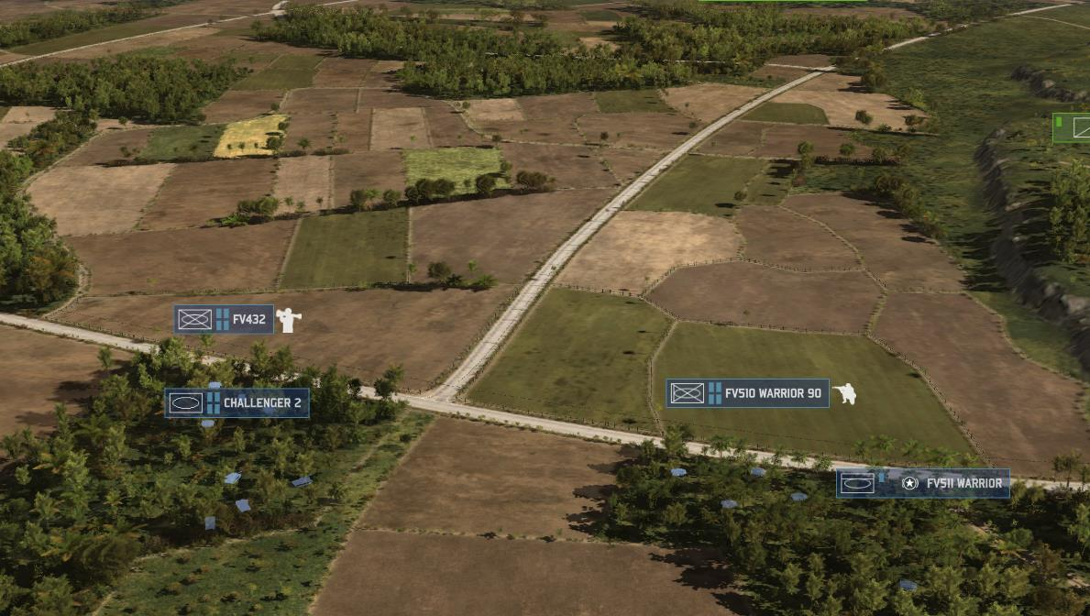
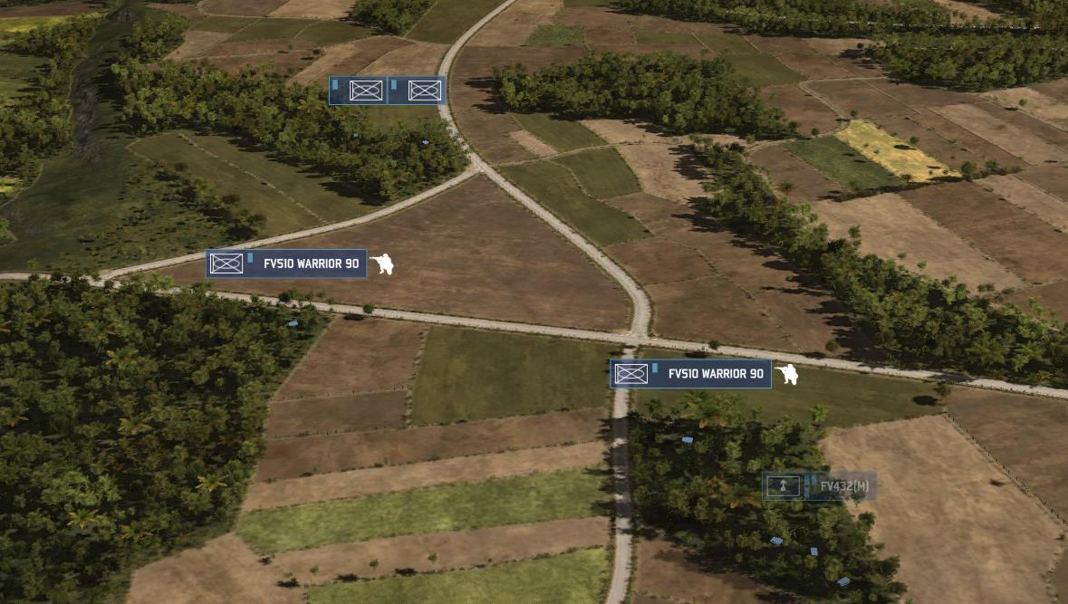
B COY POSITION AA1 1424 hrs
Horse shoe formation hoping to catch the En within a central EA.
Platoons very concentrated and infantry mounted means not all weapons covering the EAs.
RIGHT PLATOON
CENTRE PLATOON
LEFT PLATOON
Half platoon forward covering likely En approach but infantry still mounted?!
All AT dets in one group and all mounted = unable to engage
Remaining warriors can cover the EA but infantry are still mounted!?
Platoon unable to see over the crest into the EA. Infantry remain mounted for quick movement.
All tanks massed with no LoS onto EA
Platoon tightly grouped and all mounted
Mortar Section way too close to FLOT!

Slide 19
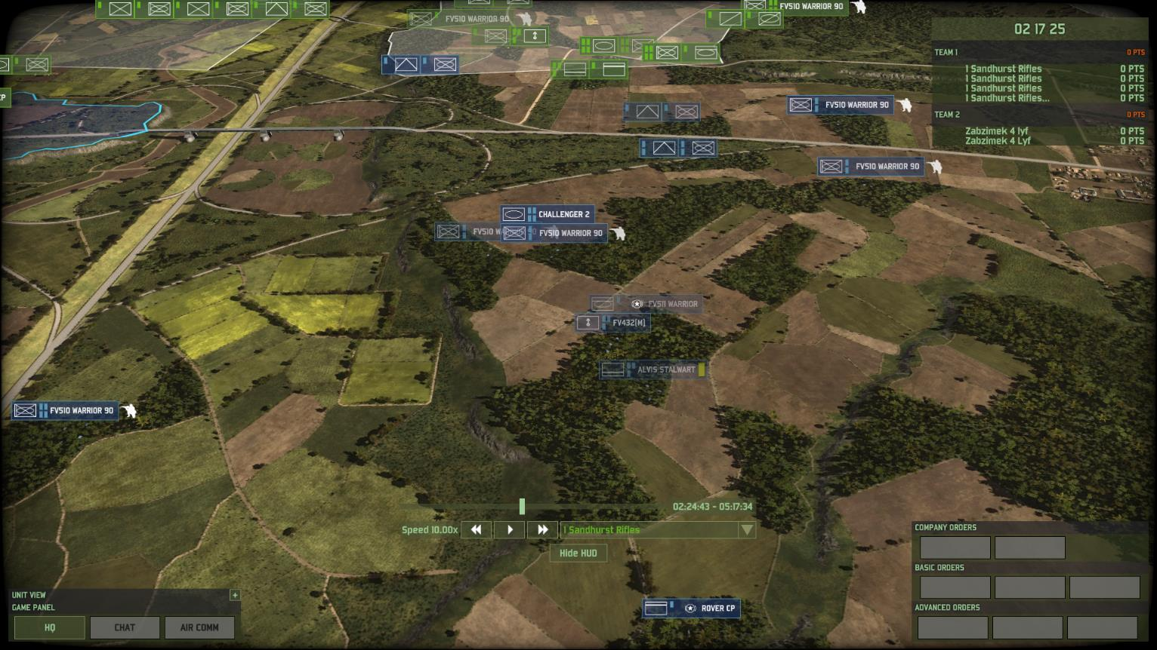
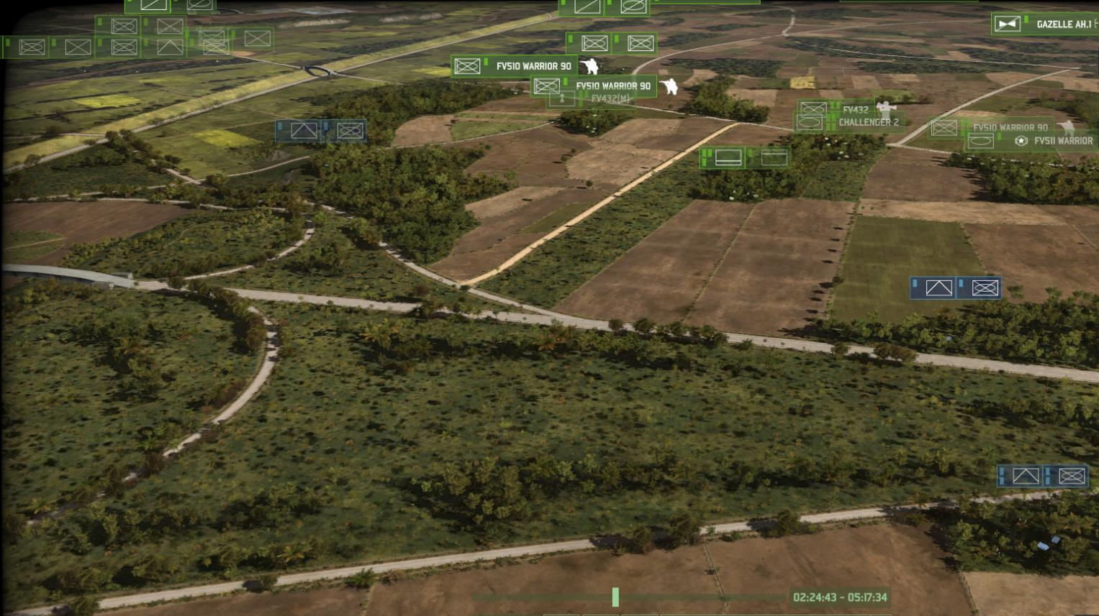
C COY POSITION AA1 1424 hrs
Disperse across Coy AO. Some AT/Inf fwd to cover pos penetration through B Coy.
Mostly mounted to move quickly if required
ANTI ARMOUR SCREEN

Slide 20
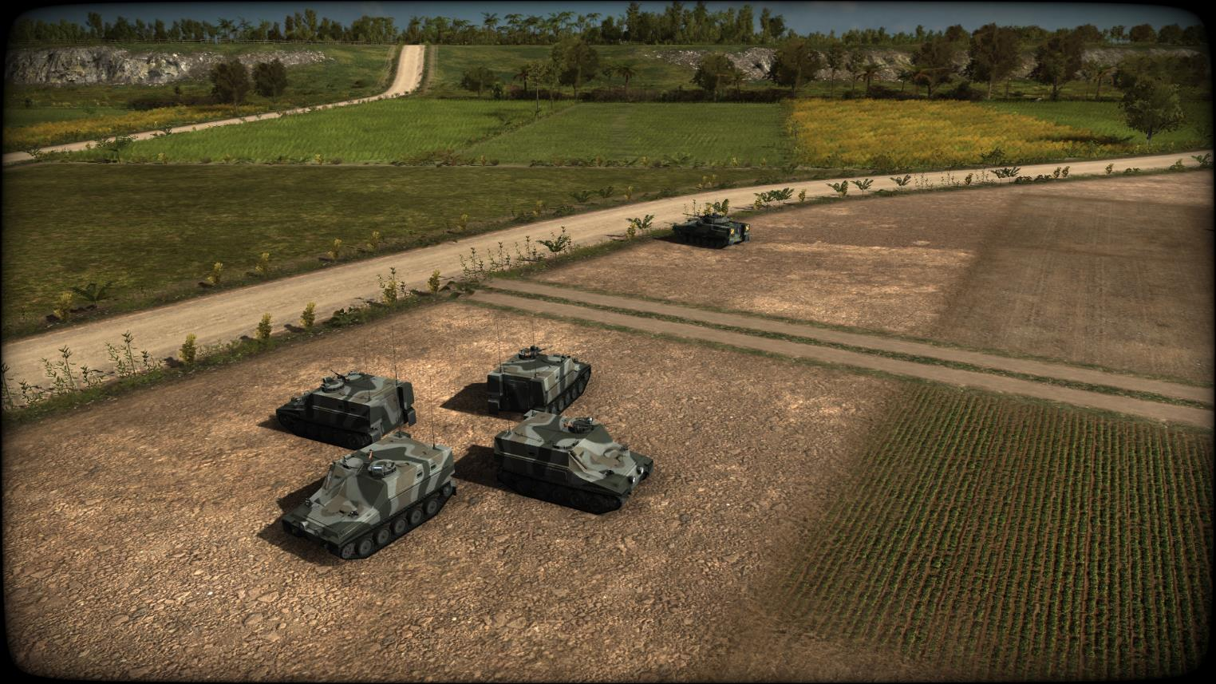
BG HQ 1424 hrs
Main = 4x Command vehicles
Tac = 1x Warrior

Slide 21
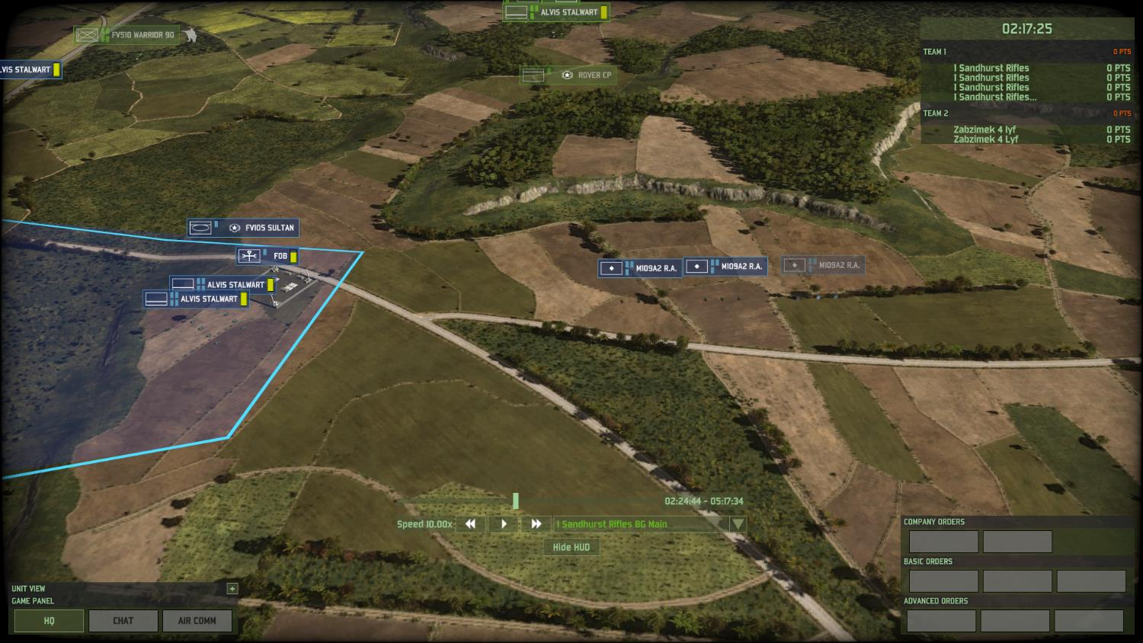
BG REAR AREA 1424 hrs
BG Log Node (A1 Ech)
Arty Bty in AMA

Slide 22
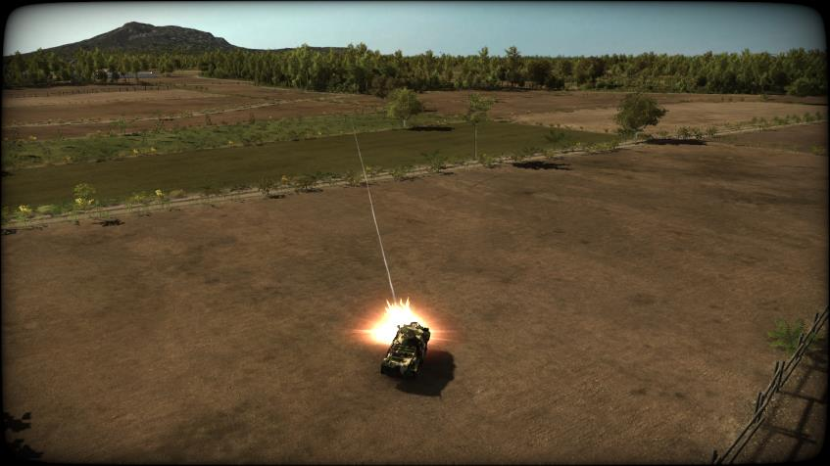
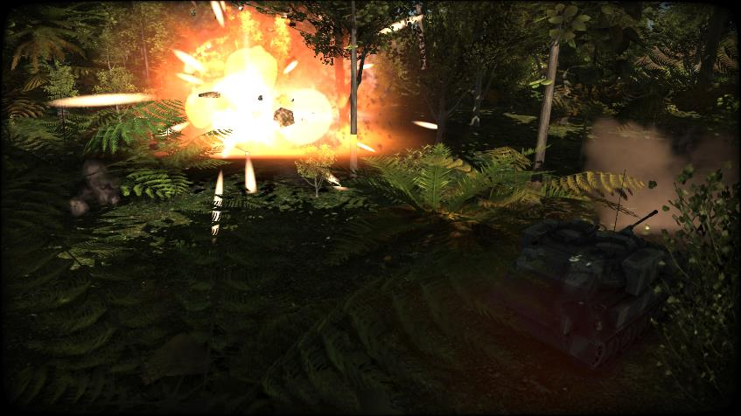
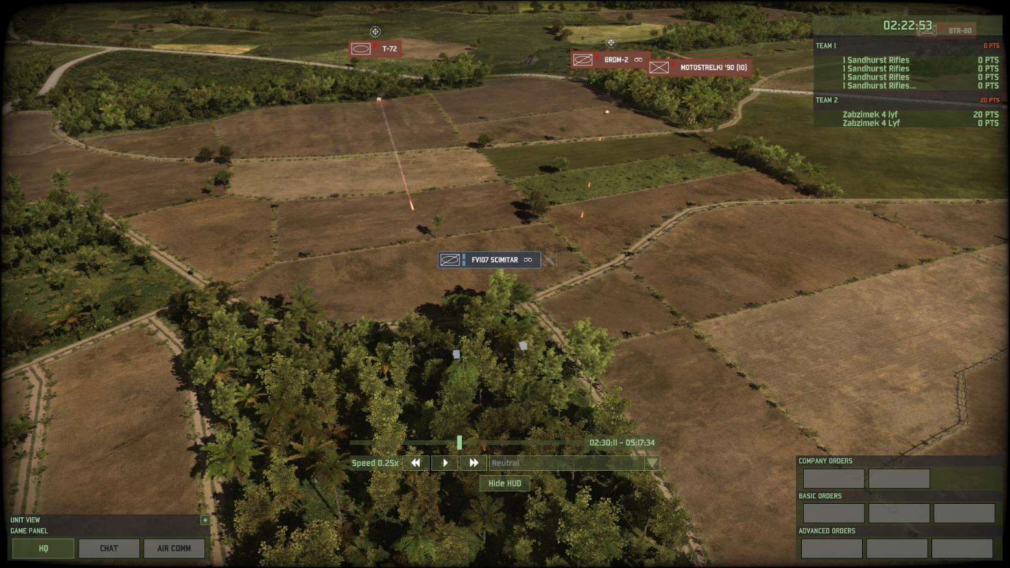
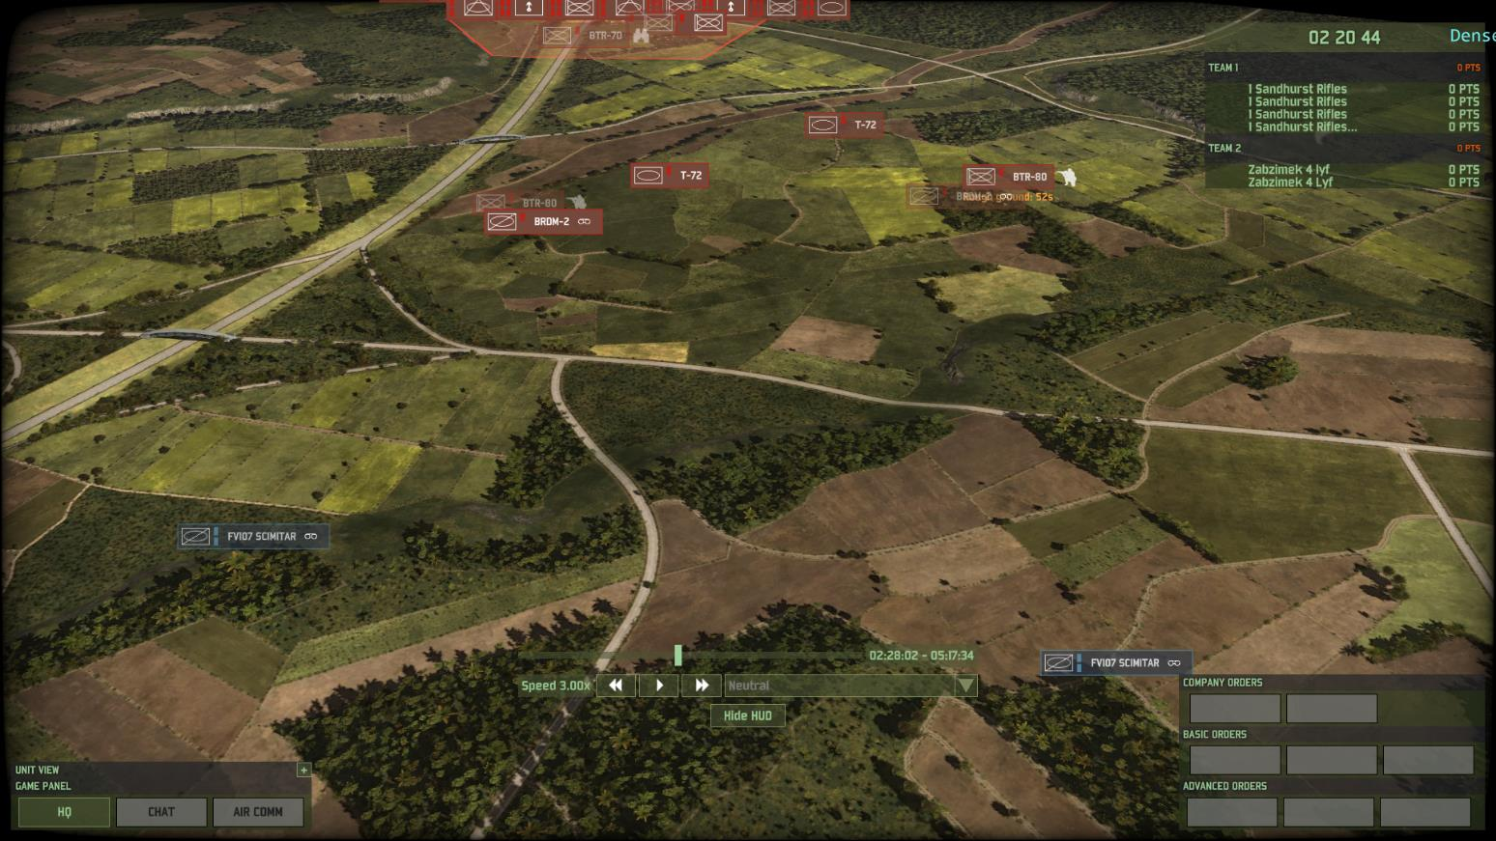
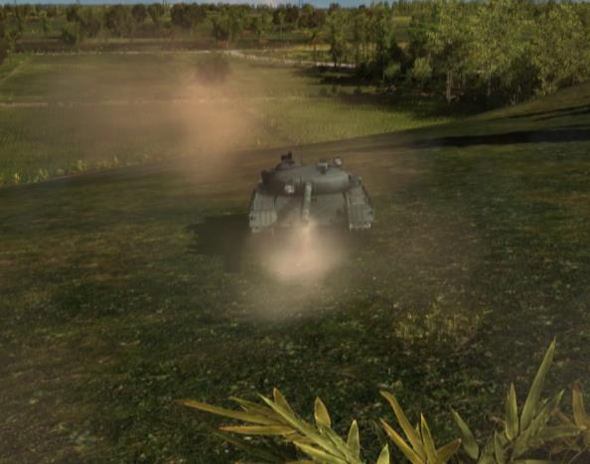
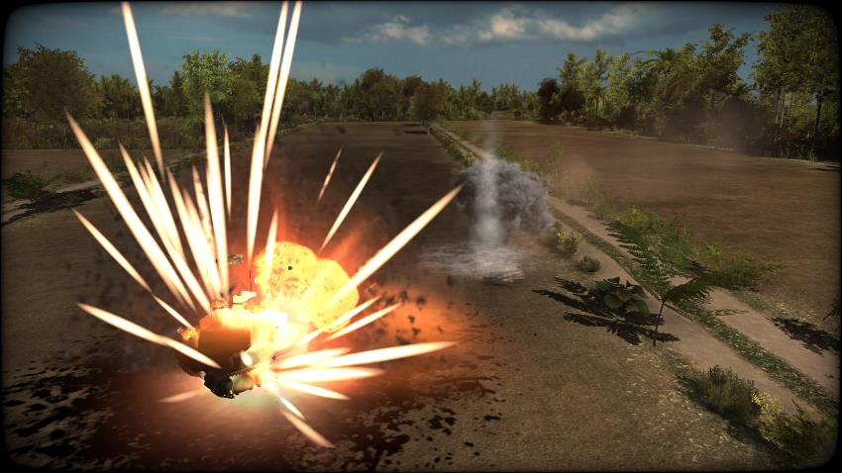
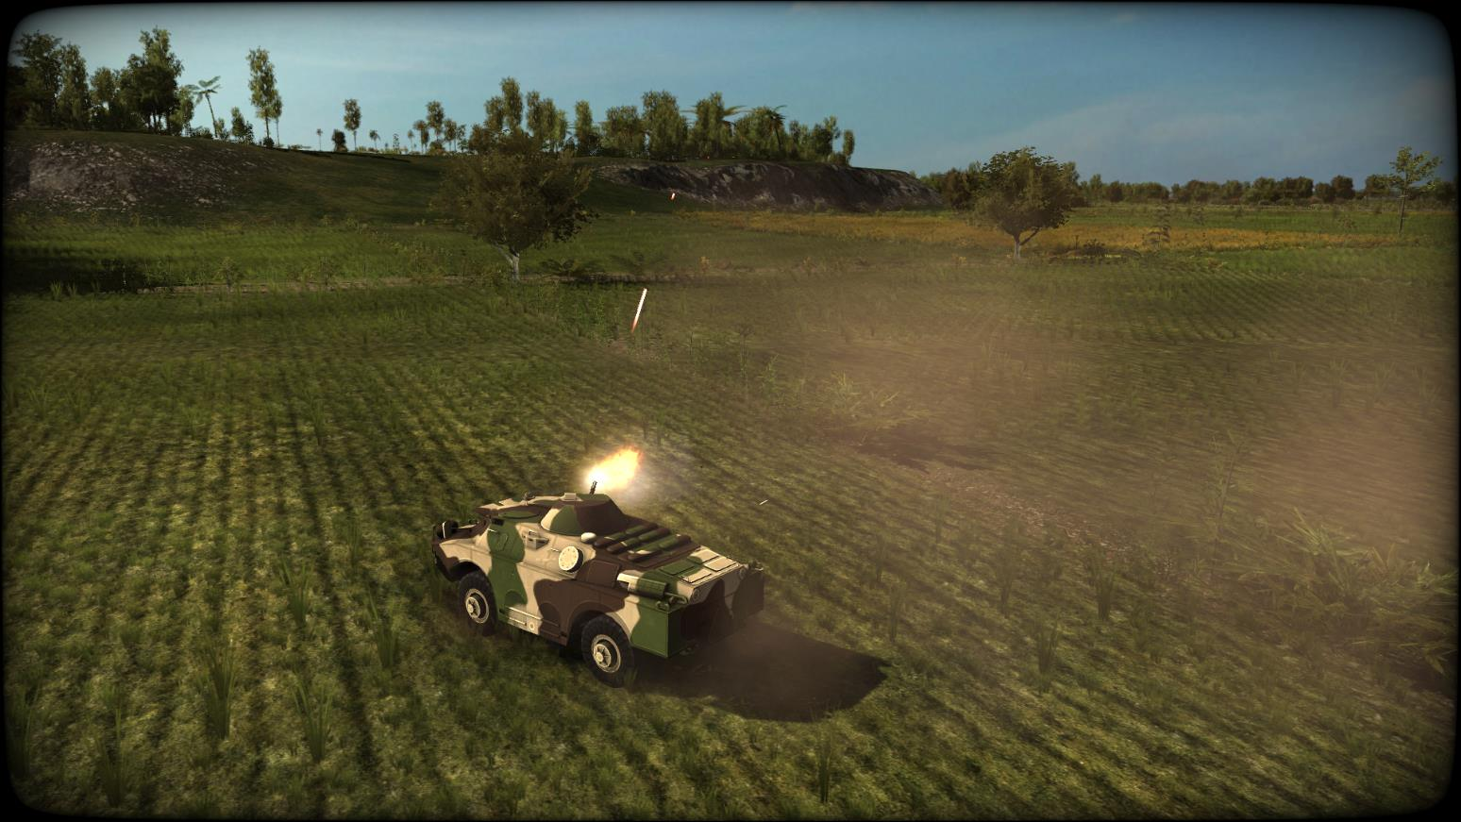
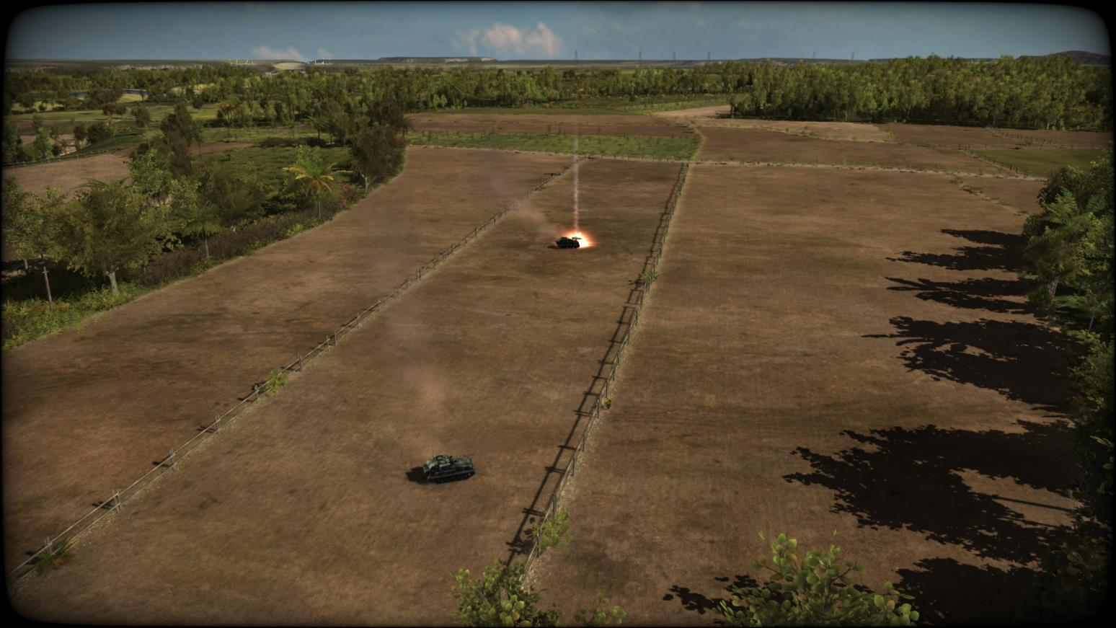
En REECE ADVANCES AA1 1428 hrs
Armed Recce (Tanks, BDRM and BTR80) advances on two axis
BG Recce withdraws
1ST CASUALTY 14:29:472
RIGHT HAND RECCE PAIR ENGAGED
2ND SCIMITAR DESTROYED
1x SCIMITAR DESTROYED
CONTACT 14:28:52
1ST HIT ON EN BDRM
BG Recce breaks contact
Each Recce Team consists of BDRM, BTR80 and T72
Scimitar destroyed
BDRM engages Scimitar with 14.5mm MG
BG Recce has not detected the En recce at this stage

Slide 23
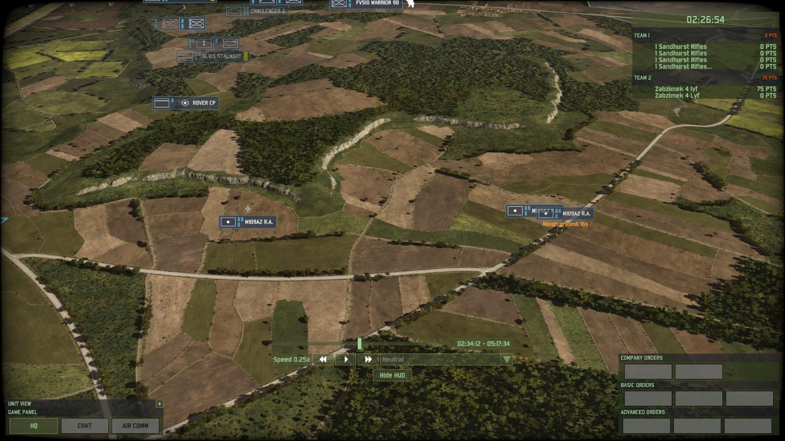
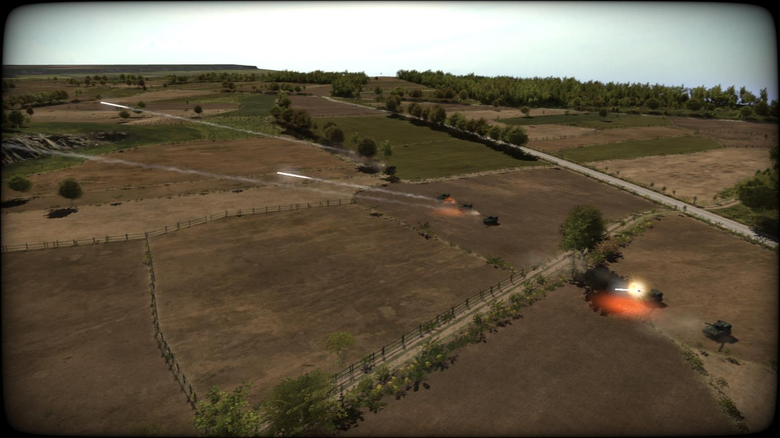
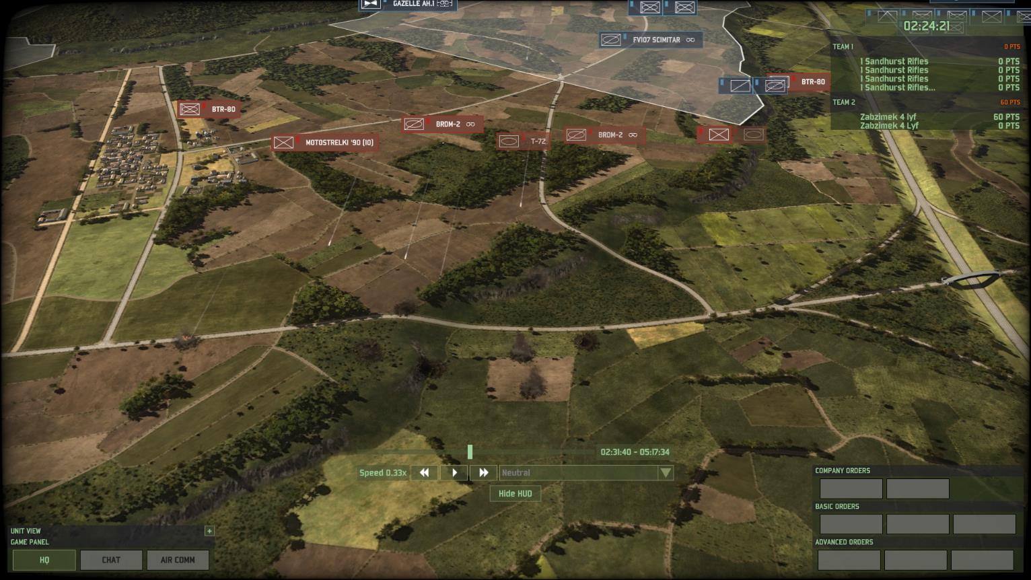
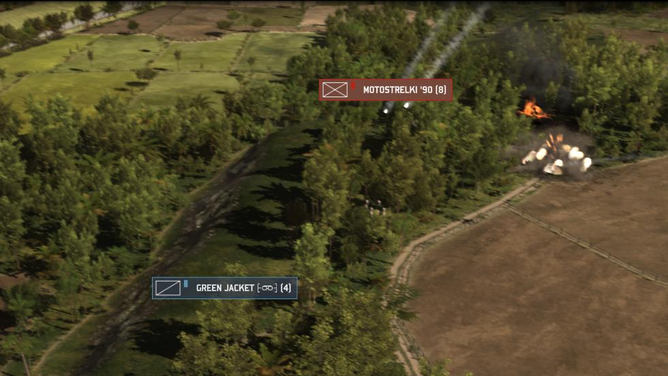
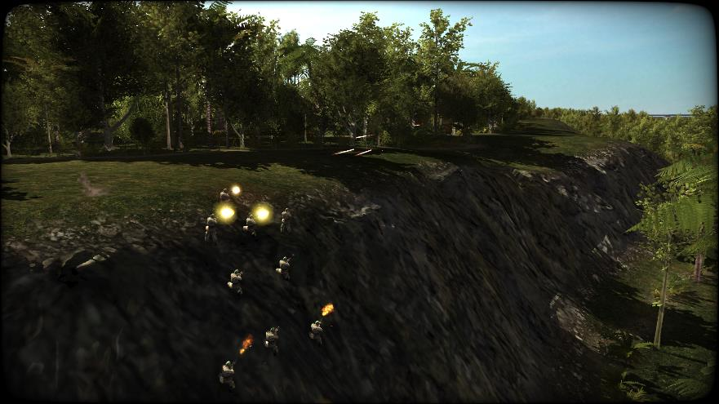
ARTILLERY UNMASKS 1431 hrs
BC ‘over-reacts’ to BG Recce losses and orders entire Bty to fire at unobserved area where he feels follow on troops are massing – 54x 155mm rnds fired = 0x En cas.
REDFOR Commander logs location of RA bty – Bty moves post fire mission
1434 ARTILLERY BATTERY REDEPLOYED
1434 ARTY FIRE IN SUPPORT OF FOO TEAM
IMPACT AREA
1433 FOO TEAM COMPROMISED AND FLUSHED OUT
IMPACT AREAS

Slide 24
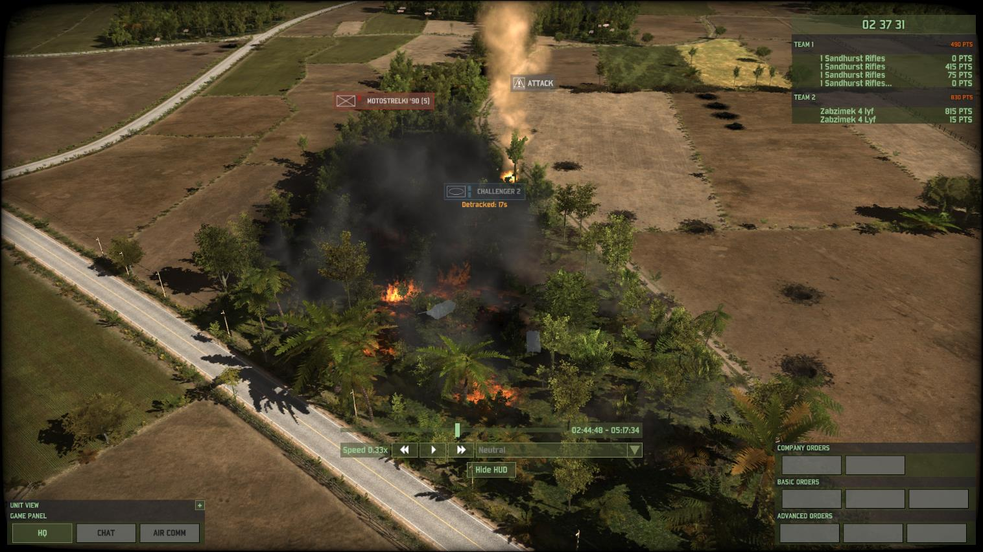
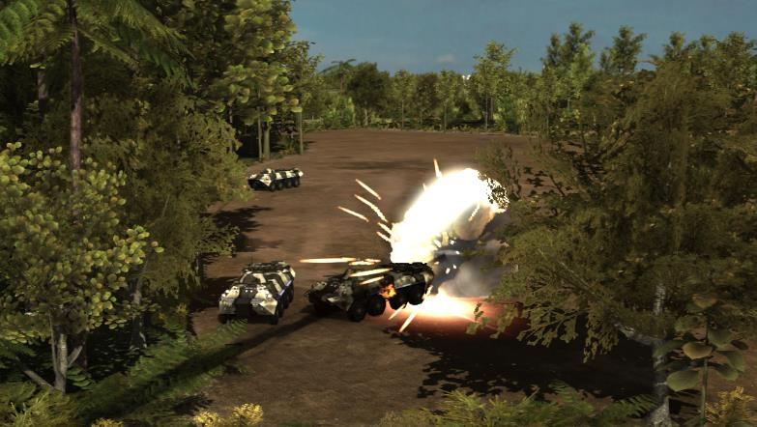
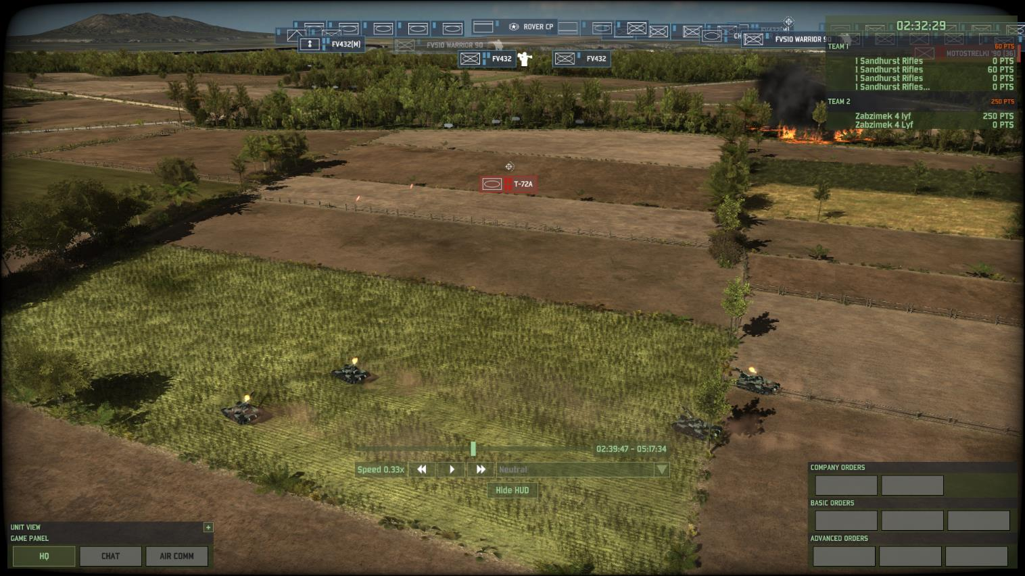
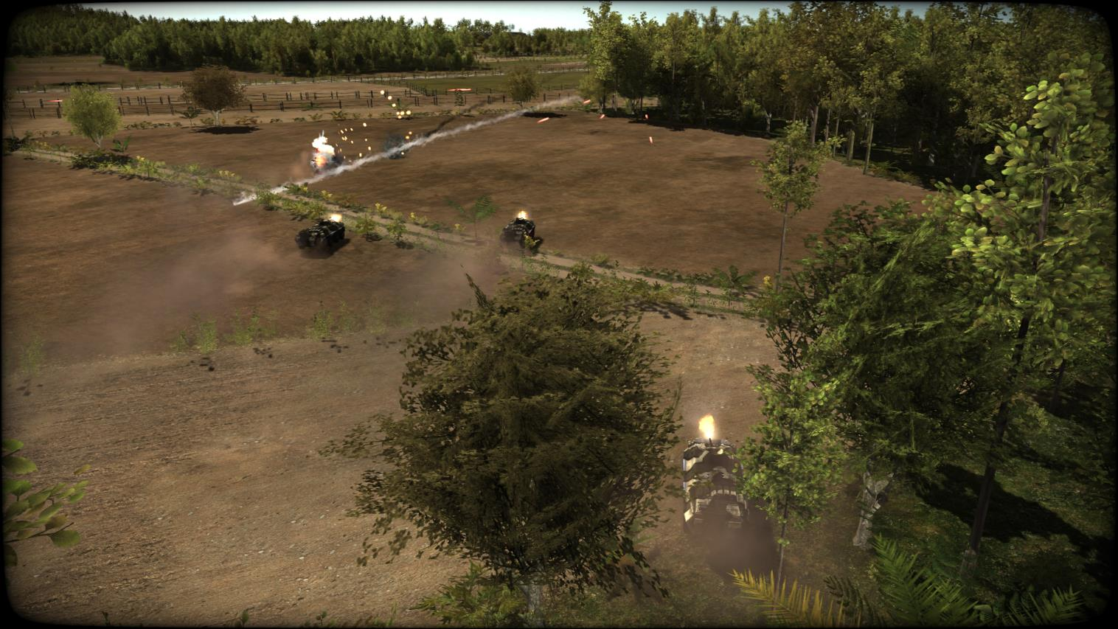
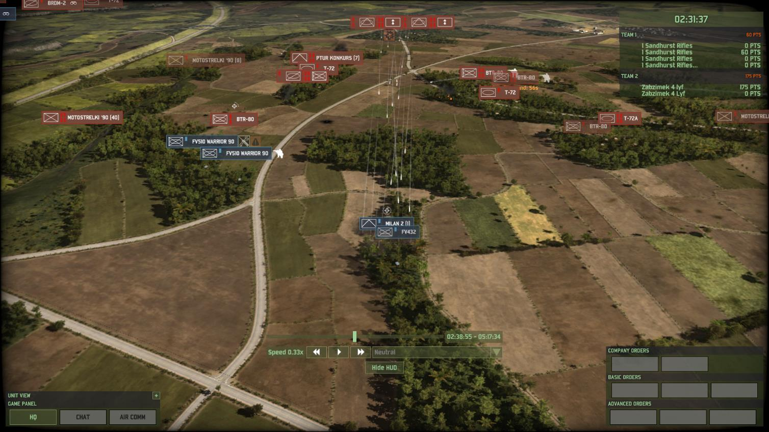
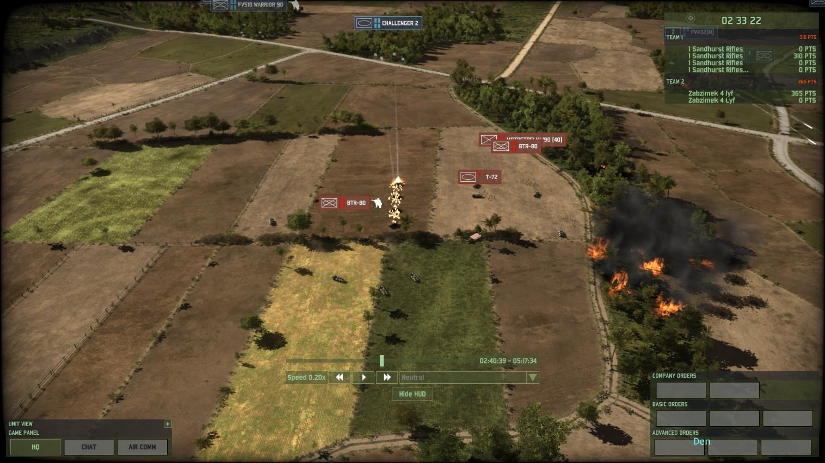
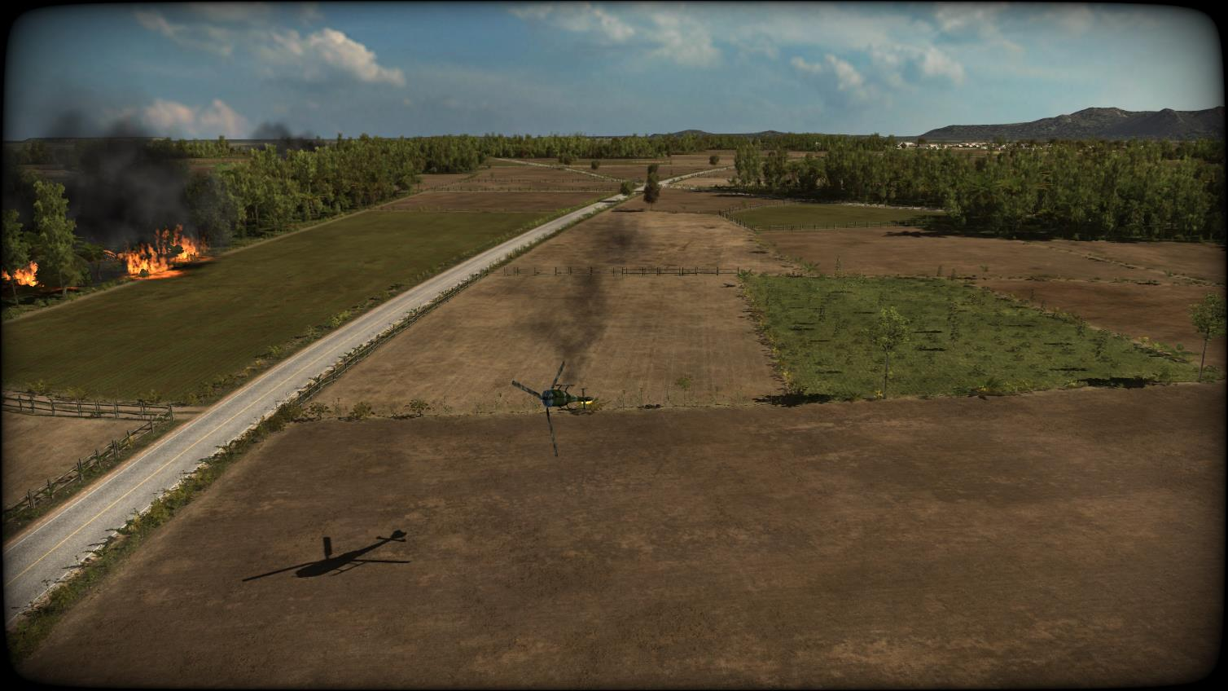
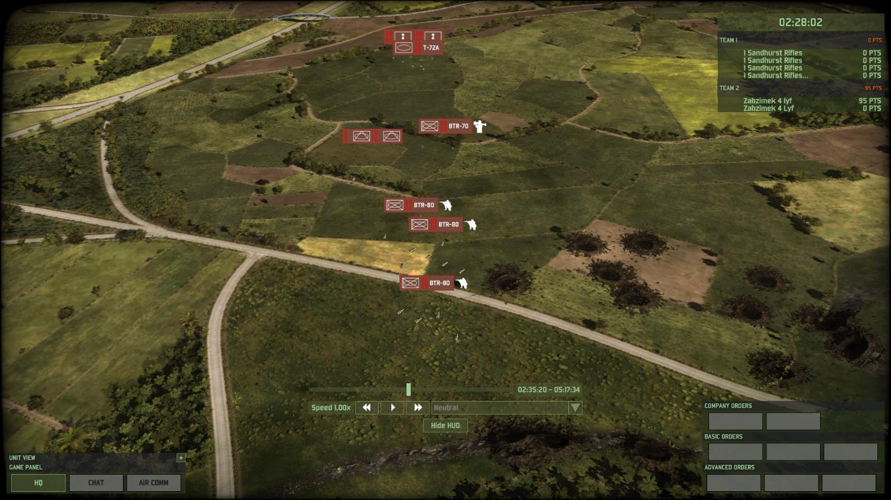
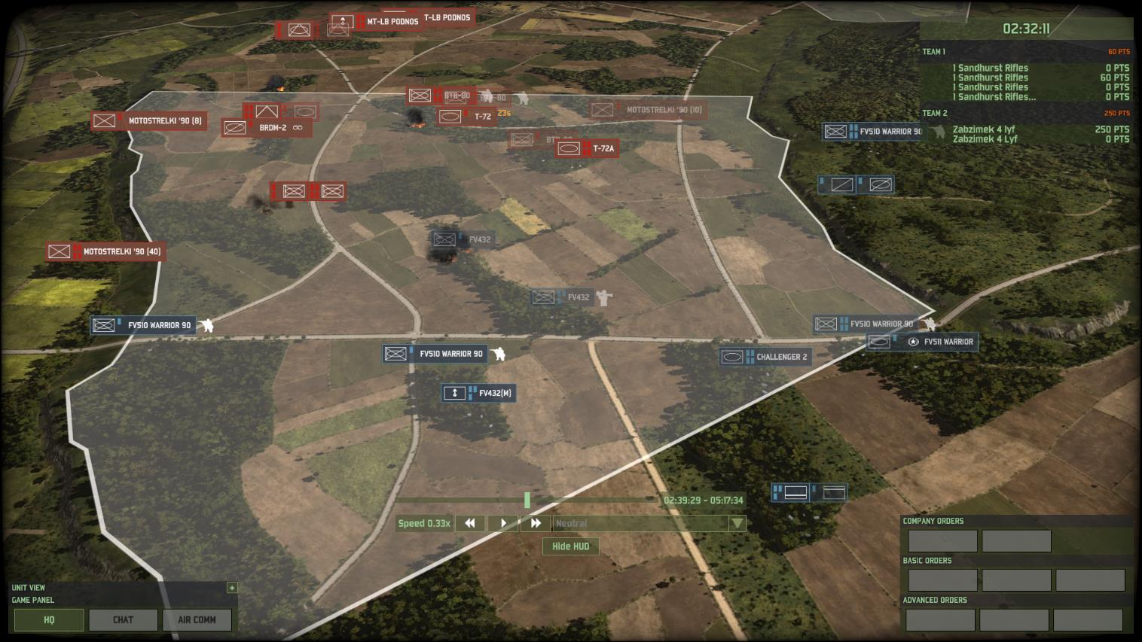
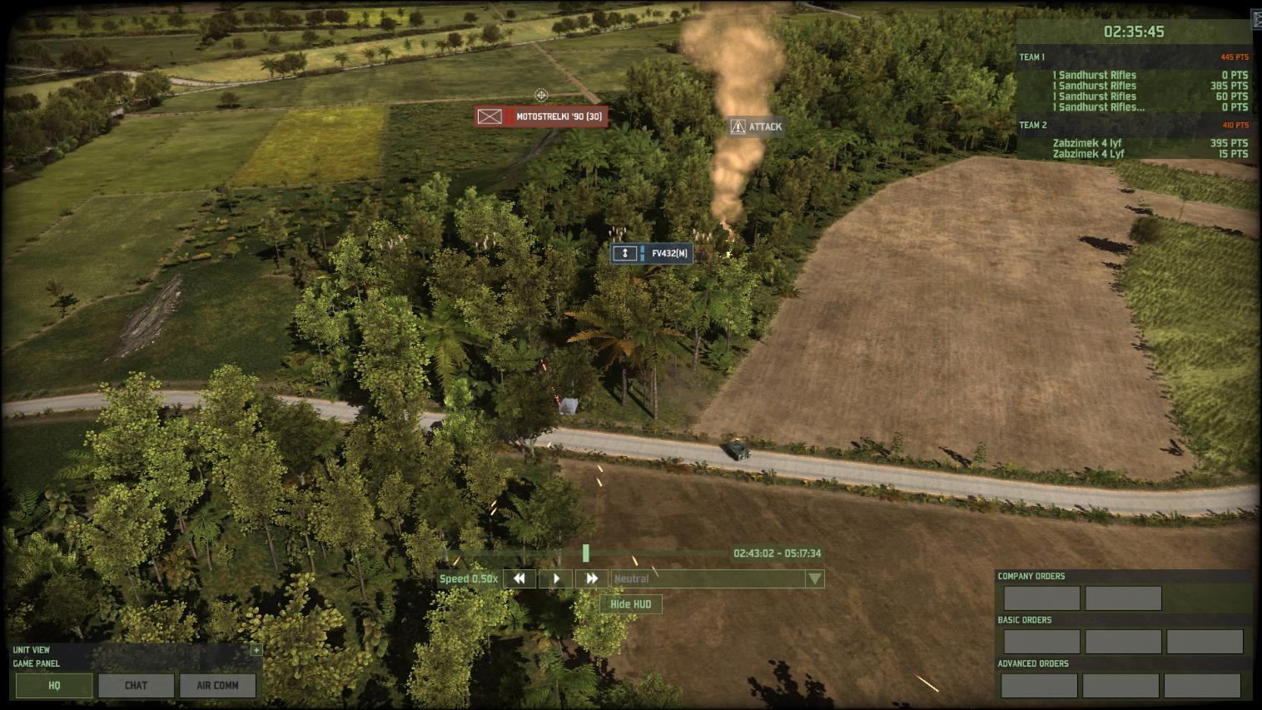
EN COY GP ADVANCES AA1 1435 hrs
Seeking to capitalise on the paucity of resistance encountered by their recce teams the REDFOR launches a hasty Coy Gp attack with T72, BTR80, Infantry supported by 82mm mortars.
B Coy posns not mutually supporting and weapons left on HOLD prevent early engagement and destruction of En probing attacks
14:44:48 B COY ARMOURED COUNTER ATTACK BLUNTED
14:37:30 GAZELLE DOWNED BY EN FIRE
14:38:55 REDFOR MORTARS NEUTRALISE AT POSN
14:38:52 REDFOR PRESSES FORWARD
14:38:36 BTR80 DESTROYED BY AT DET
14:40:39 B COY TANKS HALT REDFOR ADVANCE
14:39:29 REDFOR PLAN DEVELOPS
14:39:47 T72 TP CATCHES MOUNTED AT SECTION REDEPLOYING
14:38:30 START OF B COY BATTLE
14:43:02 B COY MORTARS DESTROYED BY REDFOR INFANTRY
14:43:43 B COY LOCAL COUNTER ATTACK
2x BTR80 pls held in reserve ready to exploit
Infantry Section gets off a lucky LAW hit on advancing BTR80 but is subsequently annihilated
BTR80 Pl reinforced by BTR70s
T72 Troop about to break out and cross EA
4x T72 destroyed in single salvo by Challenger 2 Troop
2x Challenger 2 Destroyed by half pl of REDFOR infantry in wood
Infantry Section still mounted!
Infantry Platoon dismounts and clears wood of REDFOR infantry
40x 82mm rnds used!
14:38:36 B COY MORTARS NEUTRALISE RECCE BDRM
Dismounted Inf Pl works way around flank
Warriors follow behind – with weapons still on hold
Supporting Infantry vehicles withdraw
Most B Coy units still have HOLD FIRE enabled!

Slide 25
B COY POSITION AA1 1446 hrs
8 mins of combat has resulted in B Coy losing 45% of their CE
But REDFOR unwilling to push on without tanks and artillery support
B COY Cas
3x Challenger 2
4x Warrior
5x Infantry Sections
4x AT dets
3x Mortars
REDFOR COY Cas
4x T72
5x BTR80/70
3x Infantry
REDFOR RECCE Cas
1x T72
1x BDRM

Slide 26
En COY GP ADVANCES AA2 1502 hrs
After limited success by recce REDFOR commander splits his lead Coy into two Cbt Tms and heads South to outflank the enemy positions S of Bravo.
15:07 REDFOR MORTARS FRIENDLY FIRE INCIDENT (RED ON RED)
15:10:19 2x BTR80 DESTROYED BY ANTI TANK
1508 A COY FENDS OFF REDFOR CBT TM
1509 REDFOR CBT TM BREAKS CONTACT
ARTILLERY FIRE INEFFECTIVE
15:11:30 COMBINED REDFOR MORTAR BARRAGE
15:09:09 2ND REDFOR CBT TM ENGAGED
Inf/AT Reserve
Tank/Inf Combat Team
Tank/Inf Combat Team
15:08:42 BTR80 PLATOON DESTROYED
1x Warrior and 1x Infantry Section Killed
Challenger 2s moved forward to repel T72s

Slide 27
A COY POSITION AA1 1512 hrs
7 mins of combat has resulted in A Coy only 15% of their CE
REDFOR has been significantly attrited
A COY Cas
1x Challenger 2
2x Warrior
1x Infantry Section
REDFOR COY Cas
2x T72
7x BTR80/70
4x Infantry
REDFOR RECCE Cas
1x T72
1x BDRM
1X BTR80

Slide 28
LESSONS LEARNED
Importance of being proactive in finding and tracking the enemy – much of the wargame the BLUFOR did not know what the enemy was doing.
The time delay between requesting Arty Fires and them arriving (both human and technical) – it’s called FIRE PLANNING not FIRE GUESSING.
If seen forces are highly likely to be struck by FIRES – therefore relocate to alternate/secondary positions.
Casualties will happen – have a plan to plug the gaps left in your defence or the enemy will pour through.
Compliment your forces – tanks, infantry and AT weapons all have strengths and weaknesses
The importance of the STAP (invest time into the STAP and keep building)
Communications can pose a problem for commanders – so be clear and use /practice/expect mission command
Have wider situational awareness than just your corner of the battlefield

Slide 29
SIMULATION LIMITATIONS
User familiarity – requires some ‘practice’ time
Lack of grid squares inhibits location reporting (but so does real life)
Troops cannot ‘dig in’ and therefore woods/building are the only ‘cover’
Obstacles such as minefields not represented – likewise engineering assets to breach obstacles not present
Hold Fire or Weapons Free – Needs a ‘Fire in Self Defence’ setting
Casualty/ES chain insufficiently represented (if desired to be fully replicated)
The wargame does not reward ‘mass’ as much as dispersion

Slide 30
SPECIFIC SIMULATION OMMISIONS/SETTINGS
En not given full ‘free play’ ability – it was felt they would too easily overwhelm the unfamiliar players on the BLUFOR side. Within each tactical engagement however, the REDFOR were able to free play.
A ‘near peer’ opponent (BTR80s and T72s) was chosen to allow the BLUFOR a slight qualitative overmatch (home team advantage)
Chose to replicate armour/mechanised forces – whilst these troops were unfamiliar to the cadets it allowed greater engagement distances and survivability. A fully light infantry vs light infantry engagement would require much smaller frontage.
Air forces were deliberately omitted (save a pair of tornados for the final attack) – these add another layer of complexity.
Anti Air troops/platforms were deliberately omitted

Slide 31
FURTHER SIMULATION USES
Vehicle recognition trainer – using the ‘armoury’ screen
Anti Tank screen planner/tester (but will need updating for javelin)
BG/Bde visualiser – can show all assets on the battlefield at once
TEWT trainer – if set up to represent a tactical problem it can be played through
Artillery Fire Planning Trainer – not ballistics but using an AMA, counter battery etc
GBAD visualiser/trainer – allows various air defence assets to be positioned around key targets and to execute enemy air attacks

