Slide 1
ENHANCEMENTS PROGRAMME
1st MARINE DIVISION
as at JULY 2023
V1.0

Slide 2
Enhancements to 1st Marine Division
xx
1
x
x
x
x
1
2
3
4
S
CBT
CONST
IW
1
1
1
1
1
1
1
1
1
1
1
1
ADDED ALL TERRAIN TRANSPORT COMPANY AND AMMUNITION DISPERSAL COMPANY
ADDED DECEPTION
ENGINEEING COMPANY
ADDED CHEMICAL SMOKE BATTALION
ADDED LIGHT SECURITY BATTALION

Slide 3
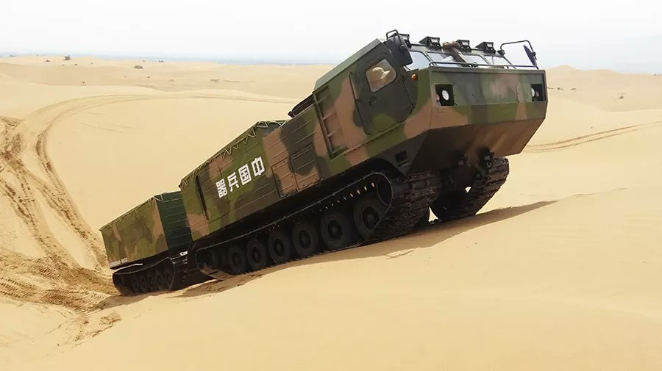
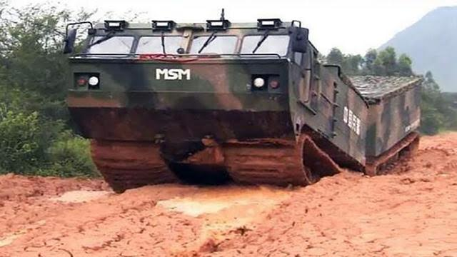
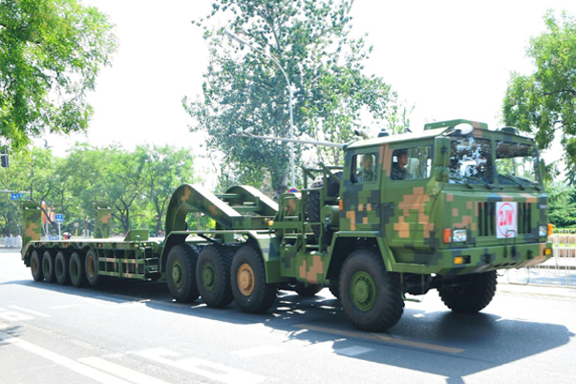
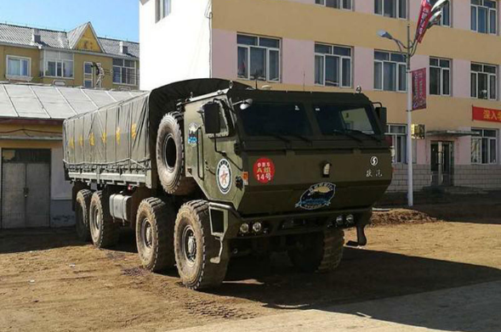
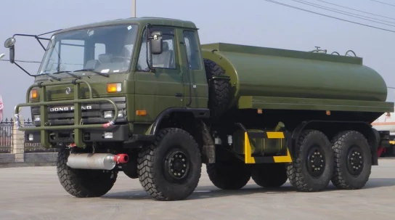
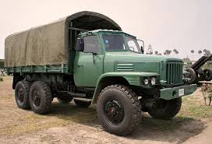
Addition of All Terrain Transport Company and Ammunition Dispersal Company to the Marine Material Support Battalion
5 X TRK EQ2050
1 X URAL 375
1
1
I
I
I
DIS
CSS
1
2
3
All Terrain Transport Coy
3 X CSK-131
6 X PYTHON LEAD UNIT
12 X PYTHON FOLLOWER UNIT
18 X TA4360 TRANSPORTER
1 X GDG-130 BACKHOE LOADER
Ammo Dispersal Coy
66 X CSK-131
18 X EQ2061E
11 X CSZ-181
36 X SX-2190 CRANE
18 X ALL-TERRAIN FORKLIFT
18 X GDG-130 BACKHOE
36 X MOTORCYCLE
6 X TRK EQ2050
14 x TRK CGO EQ2061E
2 X TRK CRANE EQ2061E
20 X TRK CGO SX2306
6 X TRK EQ2050
14 x TRK CGO EQ2061E
2 X TRK CRANE EQ2061E
20 X TRK CGO SX2306
9 X TRK EQ2050
12 X EQ2102 FUEL TANKER
30 X TRK CGO EQ2061E
2 X TRK CRANE KRAZ 255 WHL
6 X TRK WATER EQ2102 40 X TRK CGO SX2306
3 X TRK EQ2050
3 X MOTORCYCLE
4 X EQ2102
3 X ZFB-05 4X4 AMBULANCE
3 X TRK EQ2050
8 x TRK CGO EQ2061E
3 X EQ2061E
WRECKER
2 X TRK CRANE EQ2061E
2 X TRK WATER EQ2102
1
2
3
PYTHON ALL-TERRAIN
TA4360
SHAANXI SX2306
EQ2102 FUEL
EQ2061E

Slide 4
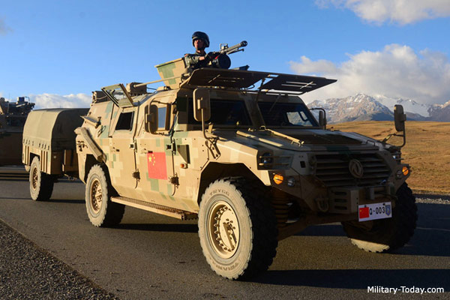
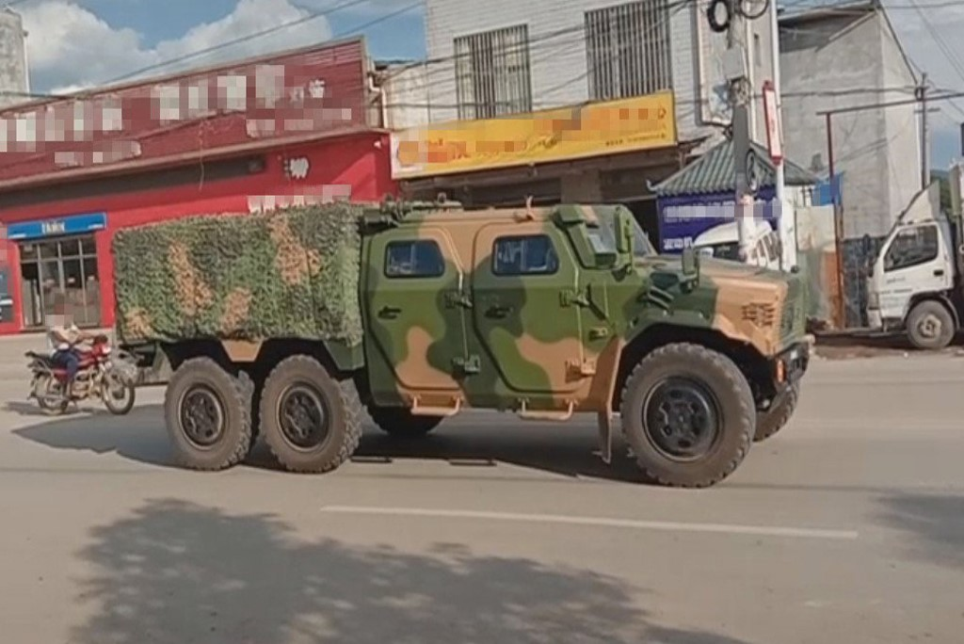
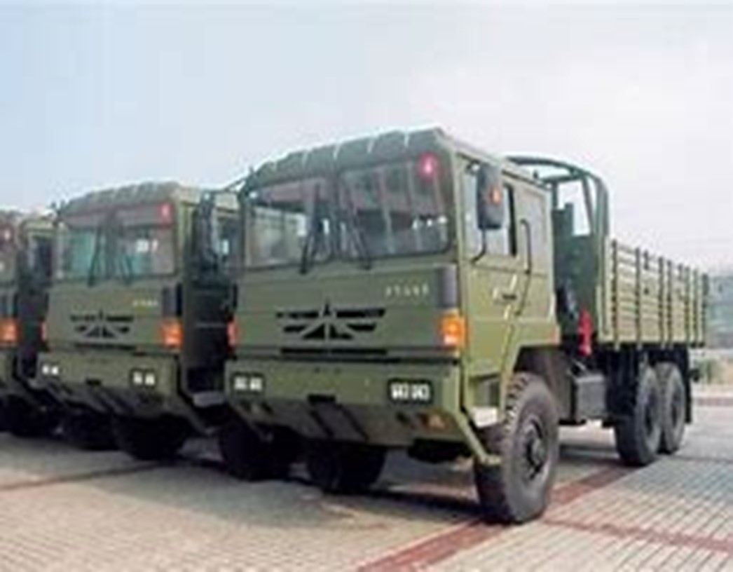
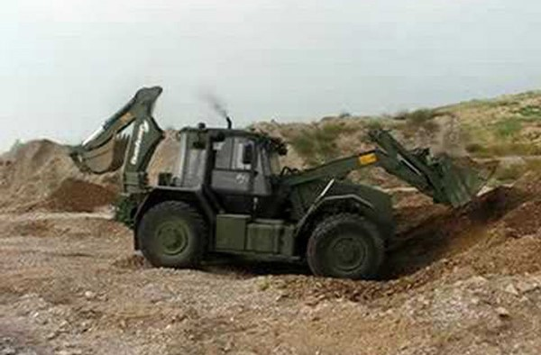
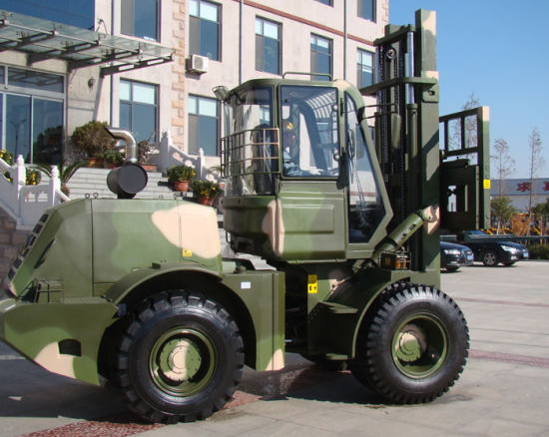
Addition of ‘Intelligent Logistics’/Ammunition Dispersal Company to the Marine Material Support Battalion
I
DIS
3 X CSK-131
3 X EQ2061E
PL HQ 10
2 X CSK-181
3 X MOTORCYCLE
DIS
DIS
DIS
DIS
DIS
DIS
CSS
1
2
3
4
5
6
3 X CSK-131
3 X MOTORCYCLE
3 X EQ2102 SIGS TRUCK
2 X CSK-131
2 X SX2190 CRANE
Ammunition Point Section 18
Security Section
3 X CSZ-181
2 X SX-2190 CRANE
2 X All-terrain Forklift
1 X GDG-130 Backhoe loader
1 X MOTORCYCLE
DIS
DIS
DIS
DIS
CSK-181
CSZ-181
SX-2190
GDG-130 BACKHOE
All Terrain Forklift

Slide 5
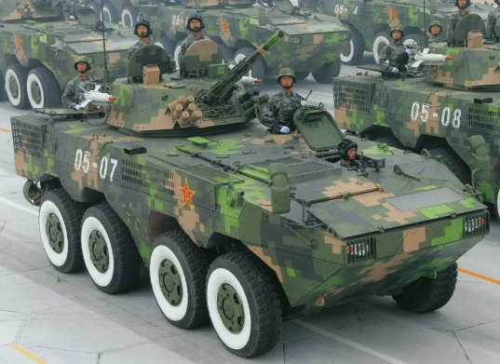
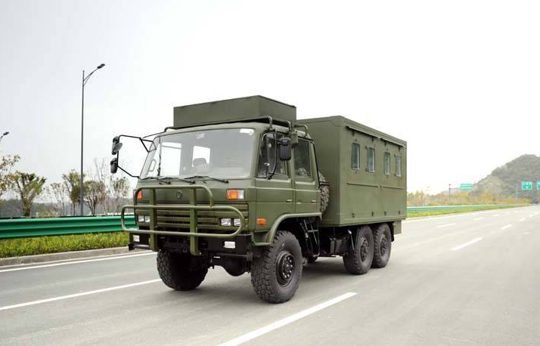
Addition of Deception Engineering Company to the Marine Infowar Battalion
IW
3 X 12.7MM
3 X URAL 375
1
1
ZBL-09
DECEPT
CI
IW
PA
DECEPTION
INFO ATK
PERCEPTION MGMT
INFLUENCE
ADDED DECEPTION
ENGINEEING COMPANY
EQ2102 SIG VAN
EW
MI
IW
CSS
INT MGMT
INFO SCTY
6 X TRK EQ2050
3 X EQ2102 RELAY
2 X EQ2102 SATCOM
2 X EQ2102 COMPUTER VAN
2 X TRK EQ2050
1 X EQ2102
2 X EQ2061E
3 X TRK EQ2050
1 X ACV ZBD-05
3 X MOTORCYCLE 1 X EQ2102 SIG VAN
3 X ZFB-05 4X4 AMBULANCE
3 X TRK EQ2050
3 X ZBL-09
8 X TRK EQ2061E
3 X EQ2061E
WRECKER
2 X CRANE EQ2061E
2 X TRK WATER EQ2102

Slide 6
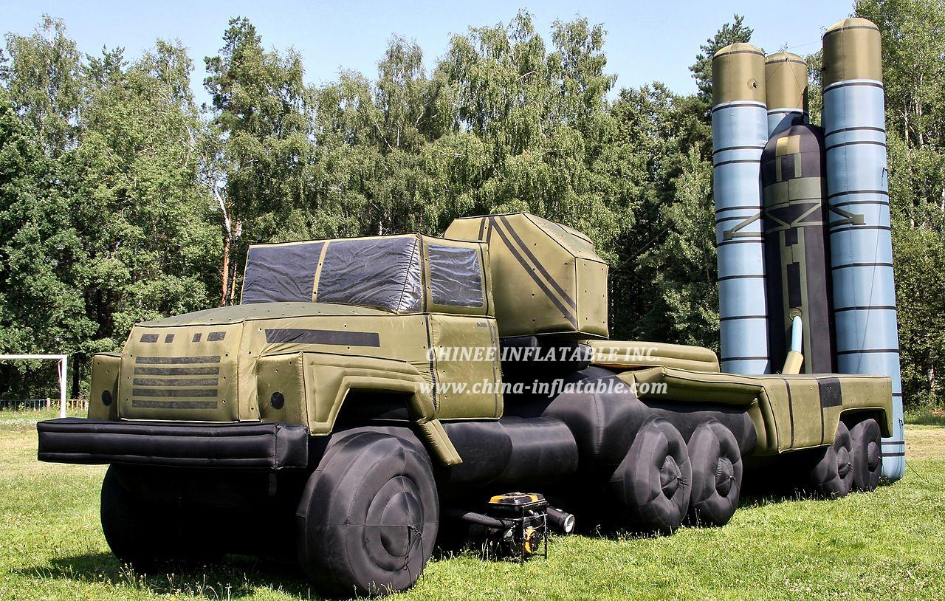
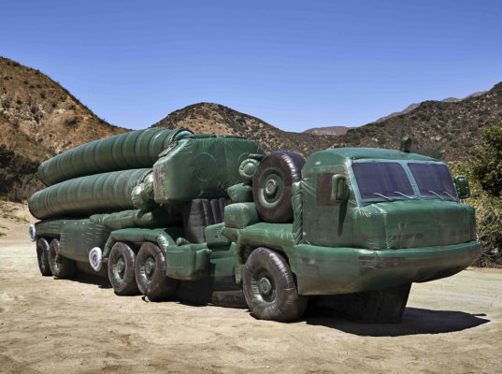
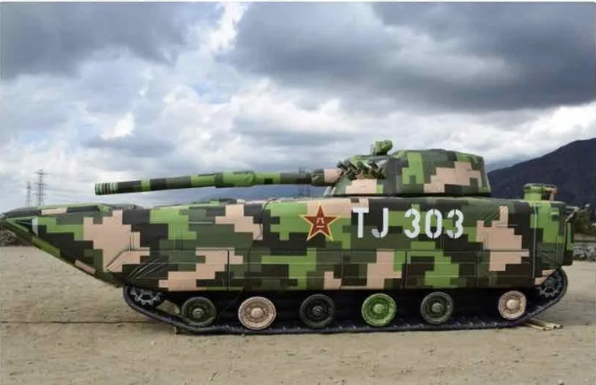
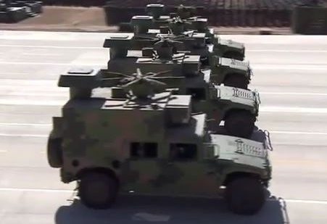
Addition of Deception Engineering Company
I
DECEPT
3 X CSK-131
3 X EQ2061E
1
1
DECEPT
DECEPT
DECEPT
DECEPT
DECEPT
DECEPT
CSS
1
2
3
4
5
6
3 X CSK-131
3 X MOTORCYCLE
3 X EQ2102 SIGS TRUCK
2 X CSK-131
2 X SX2190 CRANE
Deception Pln 29
1 X CSK-181
3 X CSZ-181
3 X SX-2190 CRANE
1 X GDG-130 Backhoe loader
1 X EQ-2050 EW
3 X MOTORCYCLE
CSK-181
CSZ-181
SX-2190
GDG-130 BACKHOE
EQ-2050 EW

Slide 7
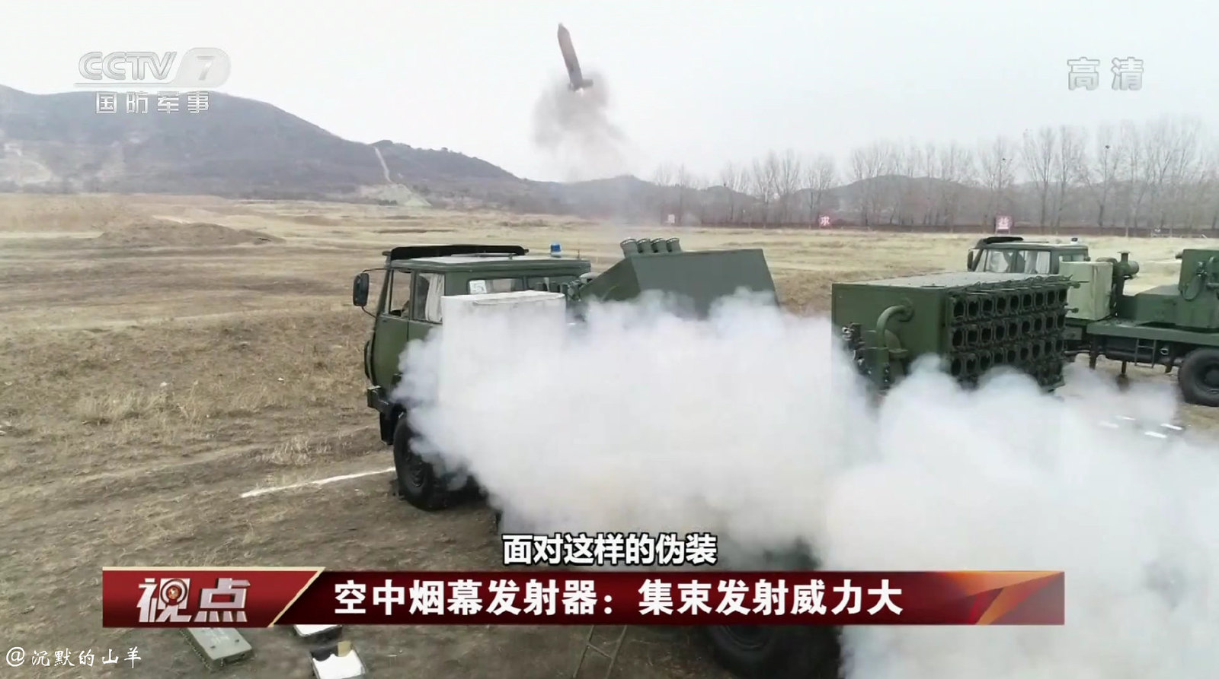
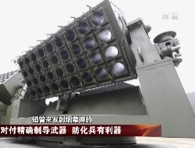
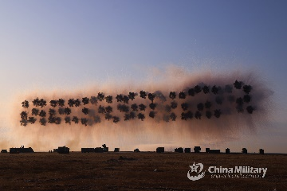
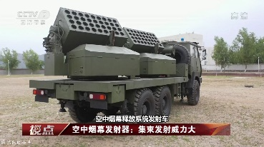
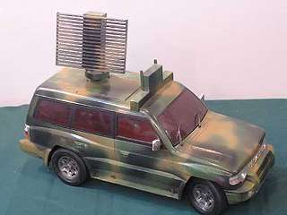
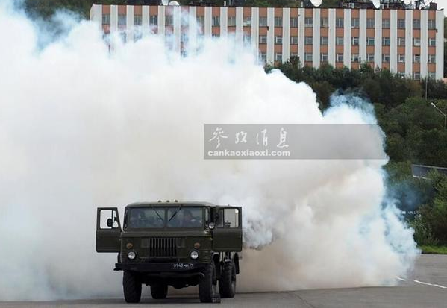
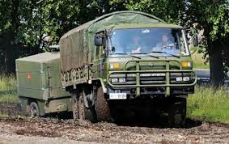
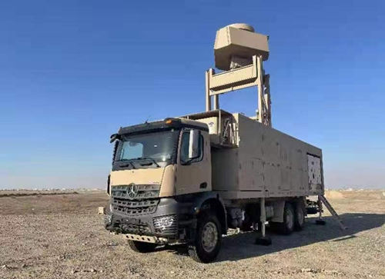
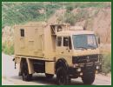
New Marine Chemical Smoke Battalion
SKYSMOKE BN
S
5 X TRK CSK-131Z
1 X BN COMD VEH
2 X 3DTWA RADAR
2 X MAINT VEH
I
I
I
S
I
S
S
S
S
CSS
S
2
3
1 X CSK-131 COMD VEH
2 X TRK CSK-131Z
1 X MAINT VEH
1 X YLC 15 RADAR ON UTILITY OR CSK-131
1 X CSK-131 COMD VEH
2 X TRK CSK-131Z
1 X MAINT VEH
3 X EQ2050 TRK
3 X EQ2050 AMB
18 X EQ2102 RESUP VEH
4 X EQ2061E REFUELLER
3 X EQ2162GS 6X6 WRECKER
3 X TRK EQ2050
3 X MOTORCYCLE
4 X GAZ 66
S
S
S
S
S
S
3 X TDA 2K SMOKE GEN VEH
3 X EQ2102 RESUP VEH
1 X COMD VEH TRK CSK-131Z
3 X T23 SKYSMOKE LAUNCHERS
3 X EQ2102 RESUP VEH
1 X COMD VEH TRK CSK-131Z
T23 SKYSMOKE MLR
YLC 15 RADAR
TDA 2K SMK GEN
EQ 2102
3DTWA RADAR
COMD/MAINT VEH

Slide 8
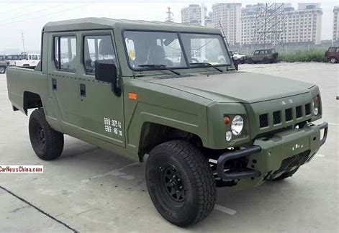
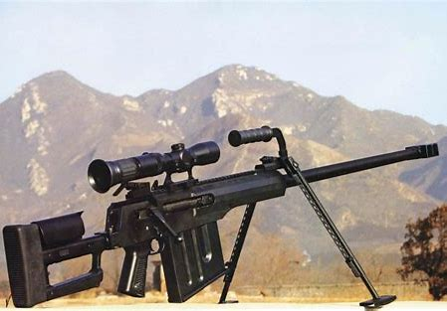
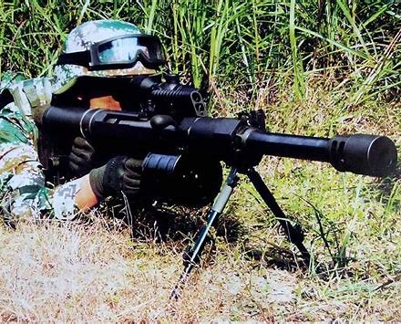
BJ2022
New 1st Marine Light Security Battalion
1 X LYNX 8X8
1 X BJ2022
1 X EQ 2102
2 X GL ATGL FHJ 84
1
1
I
I
I
1
3
4 X LYNX 8X8
4 X BJ2022
1 X EQ 2102
EQ 2102
2 X BJ2022
1 X LYNX 8X8
2
I
WPNS
CSS
PAP
1
1 X BJ2022
3 X EQ 2102
3 X QLU11 35MM AGL
18 X GL ATGL PF 89
13 X GL ATGL FHJ 84
2
3
1 X BJ2022
3 X EQ 2102
3 X QLU11 35MM AGL
3 X HJ-9A ATGM
3 X GL ATGL PF 89/98
6 X GL ATGL FHJ 84
3 X AMR-2 12.7MM
3 X LYNX 8X8
1 X BJ2022
1 X EQ 2102
8 X GL UBGL 35MM
6 X GL ATGL FHJ 84
2 X BJ2022
1 X EQ 2102
LYNX 8X8 (LOGISTIC)
AMR-2 12.7MM
QLU-11 35MM AGL

Slide 9
Addition to Marine Brigades, of the 1st Marine Division
x
UPGRADED GUNS TO AMPHIB PLZ 07B, ADDED RESUPPLY VEHICLES AND AMMUNITION POINTS
1/2/3/4
1
ADDED AMMUNITION DISTRIBUTION POINT PLATOON
11
12
13
14
1
39 X ZBD-05
39 X ZBD-05
39 X ZBD-05
39 X ZBD-05
41 X ZTD 05
3 X ARC ZBD-05
I
F
XX
S
CBT
CSS
1
1
11
1
1
1
1
1
1
X PLZ-07B 122MM
6 X MRL TYPE 90B
9 X ZBD-05 FDC
9 X PLZ-07B RESUPPLY VEHICLE
9 X SX-2306 CRANE
12 X ZLT-05
12 X HJ-12
12 X PGZ-07
6 X HQ-17A
18 X FN-6
4 X ZBD 04
12 X 25MM SP AAA T63C
2 X ACV ZBD 05
6 X ARC ZBD 05
2 X IFV ZBD 05
9 X Motorcycle
3 X 653A ARV
9 X GBL-132 MINE LAYER
4 X GQL-111 BRIDGING VEH
3 X Type 84A AVLB
2 X GCZ-111
8 X ACV ZBD 05
25 X EQ2050
3 X Motorcycle
3 X ACV ZBD 05
38 X TRK CGO
12 X T63C AMPHIP SMK MRL
3 X TDA 2K SMOKE GEN VEH
4 X EQ2102 SMOKE OIL
4 x ZBD-05 ACV
4 x CSK-181
2 X CSK-131
8 X EQ 2102
11 X CSZ-181
6 X SX-2190 CRANE
6 X ALL-TERRAIN
FORKLIFT
3 X GDG-130 BACKHOE
LOADER
1 X MOTORCYCLE
ADDED T63C AMPHIBIOUS 25MM AAA
1
1
1
1 X ARL ZBD 05
6 X URAL 375
3 X BTR 80 RKHM
9 X AAMB ZBD 05
ADDED CHEMICAL SMOKE COMPANY

Slide 10
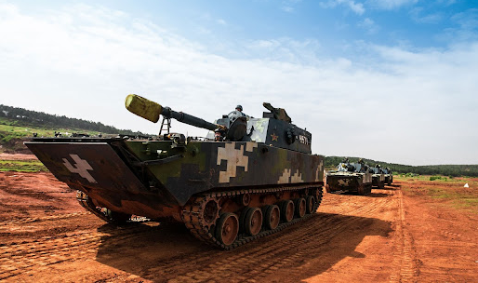
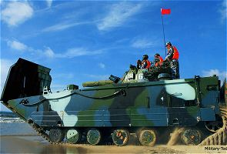
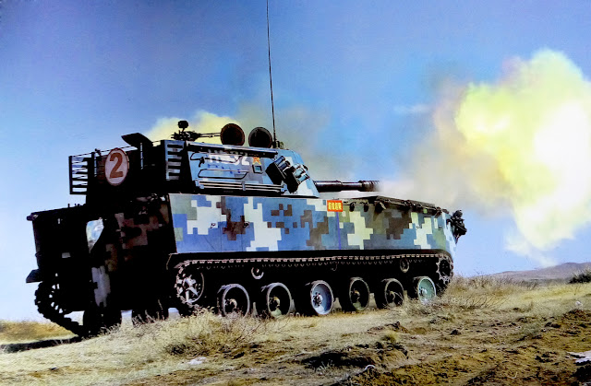
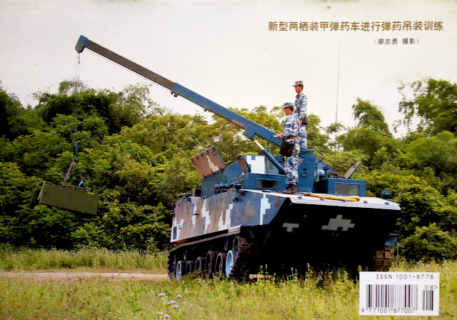
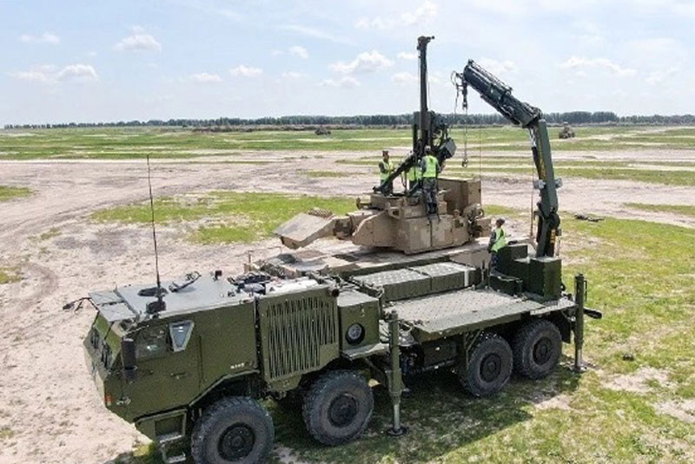
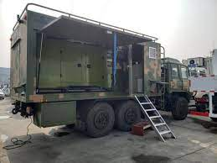
Enhancement of Artillery Company (Now Amphibious Self-Propelled Howitzer & Resupply Vehicles )
I
ZBD-05 ARV
HQ Personnel 16 - 8
1x ZBD-05 FDC/ACV
1 x CSK-181
lll
lll
lll
lll
CSS
TA
Fire SPT Pl 22
3 x ZBD-05 ARV
SP Howitzer PL 18 + 6
I x ZBD-05 FDC 3 X PLZ-07B 122MM Howitzer
3 x Motorcycle (Survey/Line Team)
ll
ll
ll
CSS
UPGRADED GUNS TO AMPHIBIOUS PLZ-O7B, FDC FOR EACH PLATOON, FORWARD AMMO SECTION FOR EACH COMPANY AND UPGRADE OF AMMO TRUCKS
Fwd Ammo Sect 18
I x ZBD-05 Security/hide Sect
3 X PLZ-07B Resupply Vehicle
2 x Motorcycle (Recce Team)
Tpt Sect 24
9 X SX-2306 Crane
3 X CSZ181
Maint Sect 14
3 X EQ2102 maint vans
2 X CSZ-181
ZBD-05 ACV
PLZ-07B 122mm HOW
PLZ-07B RESUPPLY
SX-2306
MAINT TRUCK
CSZ-181

Slide 11
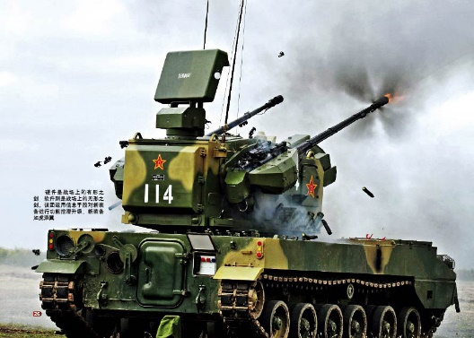
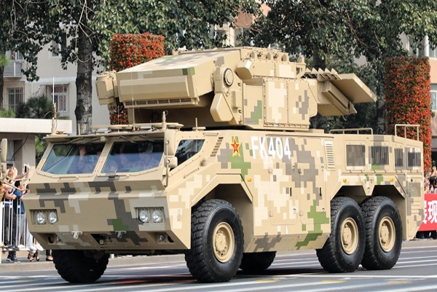
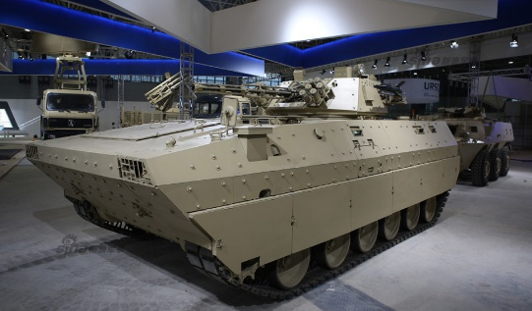
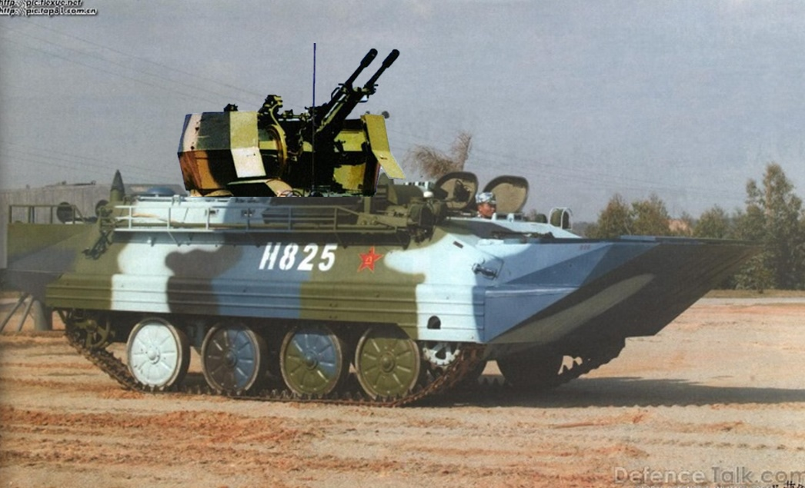
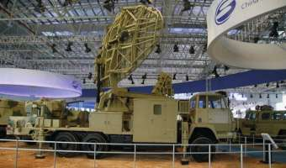
PGZ 07
Addition of Amphibious T63C CUAS Coy to AD Battalions of Marine Brigades
ADDITION OF FOUR PLATOONS OF AMPHIBIOUS AAS
5 X TRK EQ2050
5 X TRL CGO GAZ
11
1
I
I
I
I
I
I
I
HQ 17A
1
2
3
MANPAD
EW
T63C CUAS COY
PGZ 07 COY
PGZ 07 COY
3 X TRK EQ2050
6 X 35MM SP AAA PGZ 07
1 X ACV CLC 2B TRKD
1 X RDR TA CLC 2B TRKD
4 X GAZ 66
2 X URAL 375
4 X GL ATGL FHJ 84
SAM COY
3 X TRK EQ2050
6 X HQ 17 CSA 15 SAM
1 X SA 15 BATTERY C3 VEH 9S737
4 X GAZ 66
9 X SA 15 TRANSLOADER
3 X SA 15 MNT VEH
4 X GL ATGL FHJ 84
10 X ZBD 04 AIFV
3 X TRK EQ2050
4 X GAZ 66
4 X URAL 375
4 X TRL CGO
11 X GL ATGL FHJ 84
18 X FN-6
2 X ZBD 04 AIFV
5 X TRK EQ2050
3 X GAZ 66
6 X TRL CGO
2 X RDR EW 106 HGR
ZBD 04
1
2
3
4
T63C AA PLN
1 X ZBD 04
3 X 25MM SP AAA T63C
1 X TRK EQ2050
4 X GL ATGL FHJ 84
CSS
1
2
1
4 X GENERIC TRANSLOADER
5 X GAZ 66
21 X TRK CGO URAL 375
12 X URAL 375D MAINTENANCE
3 X TRK EQ2050
1 X GAX 69 4X4 CMD VEHICLE
3 X MOTORCYCLE
3 X GAZ 66
1 X GL ATGL FHJ 84
3 X BJ 212 4X4 AMBULANCE
2 X TRK EQ2050
1 X GAZ 66
8 X TRK CGO
5 X GL ATGL FHJ 84
EW 106 HGR
T63C 25MM AAA

Slide 12
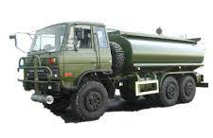
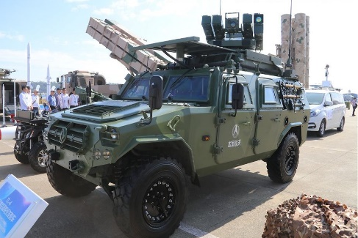
Addition of Distribution Platoon to Marine Material Support Companies of Marine Brigades
I
3 X TRK EQ2050
1 X GAZ 66
1 X URAL 375
EQ2102
CSS
1
1
DIS
PL HQ 10
2 X CSK-181
3 X MOTORCYCLE
CSS
1
2
POL
3 X AAMB ZBD 05
3 X ARV ZBD 05
3 X TRK EQ 2050
1 X EQ2102
8 X TRK CGO EQ2061E
3 X EQ2061E 6X6 WRECKER
2 X TRK CRANE EQ2061E
EQ2050
1 X TRK EQ2050
10 X TRK CGO EQ2061E
2 X TRK CRANE EQ2061E
1 X TRK EQ2050
4 X EQ2102 FUEL TANKER
10 X TRK CGO EQ2061E
DIS
DIS
DIS
Ammunition Point Section 18
Security Section
3 X CSZ-181
2 X SX-2190 CRANE
2 X All-terrain Forklift
1 X GDG-130 Backhoe loader
1 X MOTORCYCLE
ADDED AMMUNITION DISTRIBUTION POINT PLATOON
EQ2061E
CSK-181
CSZ-181
SX-2190
GDG-130 BACKHOE
All Terrain Forklift

Slide 13
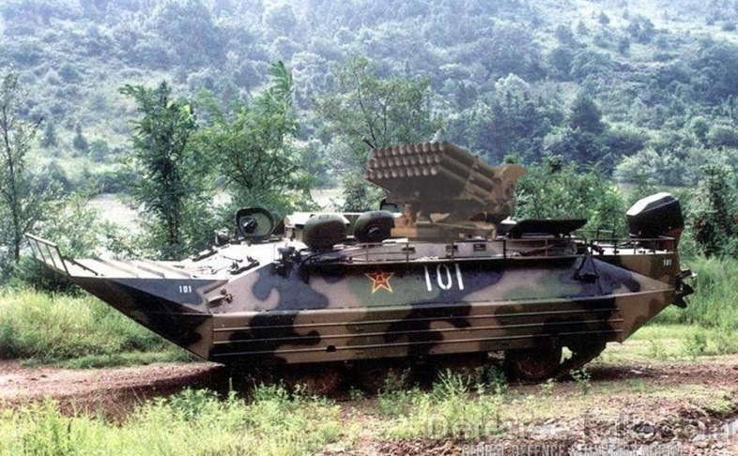
Addition of Chemical Smoke Company to Marine Brigades
CSK-181
I
S
3 X CSK-131
1 X EQ 2102
1
1
S
S
S
S
S
CSS
ZBD-05 ACV
1
2
3
4
1x ZBD-05 ACV
1 x CSK-181
3 X T63C AMPHIP SMK GENERATOR & MRL VEH
4 X CSK-131
4 X EQ2102 SMOKE OIL
4 X EQ 2102
3 X TDA 2K SMOKE GEN VEH
3 X EQ2102 RESUP VEH
1 X COMD VEH TRK CSK-131Z
TYPE 63C AMPHIB WITH SMOKE MRL & SMOKE GENERATOR
TDA 2K SMOKE GENERATOR VEH
EQ 2102
EQ2102

